Slide 1

E4S: The Extreme-scale Scientific Software Stack Release 25.11
Release 25.11 notes
November 14, 2025
High Performance Software Foundation
E4S Team
https://e4s.io

Slide 2

E4S 25.11: What’s New?
E4S includes 125+ HPC-AI packages on aarch64, x86_64, and ppc64le platforms.
All new website [https://e4s.io] with an OpenAI based chatbot to simplify access to E4S documentation.
Support for NVIDIA Blackwell on x86_64 and aarch64 (Grace-Blackwell) architectures.
Support for Rocky Linux 9.6 with Hopper and Blackwell (x86_64 and aarch64), Ubuntu 24.04 LTS.
Spack 1.0.2 [https://spack.io] integration.
All new E4S Spack build cache [https://cache.e4s.io/25.11] with over 7500 optimized binaries.
AI software stack with Python 3.12.11 including packages like NVIDIA BioNeMoTM, NVIDIA NeMoTM, Google Agent Development Kit (adk), Vllm, HuggingFace CLI, TensorFlow, PyTorch, Google.genai (Gemini API), OpenAI (API), TorchBraid, Pandas, Scikit-Learn, JAX, OpenCV, LBANN and Codium, Jupyter, and Marimo notebooks.
HPC Applications include: CP2K, DealII, FFTX, GROMACS, LAMMPS, Nek500, Nekbone, NWChem, OpenFOAM, WarpX, WRF, Quantum Espresso, and Xyce with GPU support where available.
CUDA upgraded to 12.9 (aarch64, x86_64), ROCm upgraded to 6.4.3, oneAPI upgraded to 2025.2.
Adaptive Computing’s Heidi web-based platform for multi-user, multi-node, ParaTools Pro for E4STM cloud images on AWS, Microsoft Azure, Google Cloud, IBM Cloud, and OCI with NVIDIA GPUs with SLURM or Torque.
https://adaptivecomputing.com/ and https://paratoolspro.com
https://e4s.io

Slide 3
E4S Spack Integration
E4S is a curated, Spack based distribution of HPC-AI software.
Major Changes in Spack 1.0.2
Compilers as First-Class Dependencies: Compilers are now treated as proper dependencies in the concretization process, leading to clearer and more reproducible environments.
Stable Package API: Spack 1.0 introduces a stable API for package development, improving long-term maintainability and easing contributions.
Concurrent Builds: Builds can now run concurrently, leveraging parallel jobs and increasing throughput on multi-core machines.
Updated Install Tree Layout: The default install tree format is revamped for better organization and reproducibility.
Content-Addressed Build Caches: Binary caches now use content-based addressing, improving the reliability and provenance of shared binaries.
Improved Git Provenance: Enhanced mirroring and fetching mechanisms for package sources and dependencies.
Visit spack.io
github.com/spack/spack

Slide 4











E4S: Extreme-scale Scientific Software Stack
About E4S
https://e4s.io
E4S is an ecosystem for science and a community effort to provide open-source software packages for developing, deploying and running scientific applications on HPC platforms.
E4S has built a comprehensive, coherent software stack that enables application developers to productively develop highly parallel applications that effectively target diverse exascale architectures.
E4S provides a curated, Spack based software distribution of 125+ HPC (TAU, Trilinos, PETSc,OpenFOAM, Gromacs, Nek5000, LAMMPS), EDA (e.g., Xyce), and AI/ML packages (e.g., Google ADK, NVIDIA NeMoTM, NVIDIA BioNeMoTM, Vllm, HuggingFace CLI, TensorFlow, PyTorch, OpenCV, TorchBraid, Scikit-Learn, Pandas, JAX, LBANN optimized for GPUs where available).
Base images and full featured containers (with GPU support) and DOE LLVM containers.
Commercial support for E4S through ParaTools, Inc. for installation, maintaining an issue tracker, and ECP AD engagement.
E4S for clouds: Adaptive Computing’s Heidi with ParaTools Pro for E4STM image for AWS, GCP, IBM Cloud, Azure, OCI.
With E4S Spack binary build caches, E4S supports both bare-metal and containerized deployment for GPU based platforms.
x86_64, ppc64le (IBM Power 10), aarch64 (ARM64) with support for CPUs and GPUs from NVIDIA, AMD, and Intel
Container images on DockerHub and E4S website of pre-built binaries of ECP ST products.
e4s-chain-spack.sh to chain two Spack instances allows us to install new packages in home directory and use other tools.
e4s-cl container launch tool allows binary distribution of applications by swapping MPI in the containerized app w/ system MPI.
e4s-alc is an à la carte tool to customize container images by adding system and Spack packages to an existing image.
E4S 25.11 released on November 14, 2025: https://e4s.io/talks/E4S_25.11.pdf
Notes:
LOCAL LAB POC: Michael Heroux (maherou@sandia.gov)
TALKING POINTS:
PESO is a five-year post-ECP software-ecosystem stewardship and advancement project. In partnership with the Consortium for the Advancement of Scientific Software (CASS), PESO will establish and steward a sustainable scientific software ecosystem comprising libraries and tools that deliver the latest high-performance algorithms and capabilities for DOE mission-critical applications.
PESO will enable applications to realize 100X improvement in both high-end capabilities and energy efficiency by leveraging accelerator devices
PESO will emphasize software product quality, the continued fostering of software product communities, and the delivery of products, working with CASS
METADATA:
Name of the associated awarded project:
PI name(s): Michael Heroux (Sandia), Lois Curfman McInnes (Argonne)
Name of the program manager: William Spotz, Software Stewardship and Advancement
CITATIONS:
The notes section should also include full citations (including the DOI) to any important and associated publications, datasets or code developed as part this work.
N/A
AWARDS:
N/A
REPRODUCIBILITY:
N/A.
BACKGROUND AND CONTEXT INFORMATION:
N/A

Slide 5
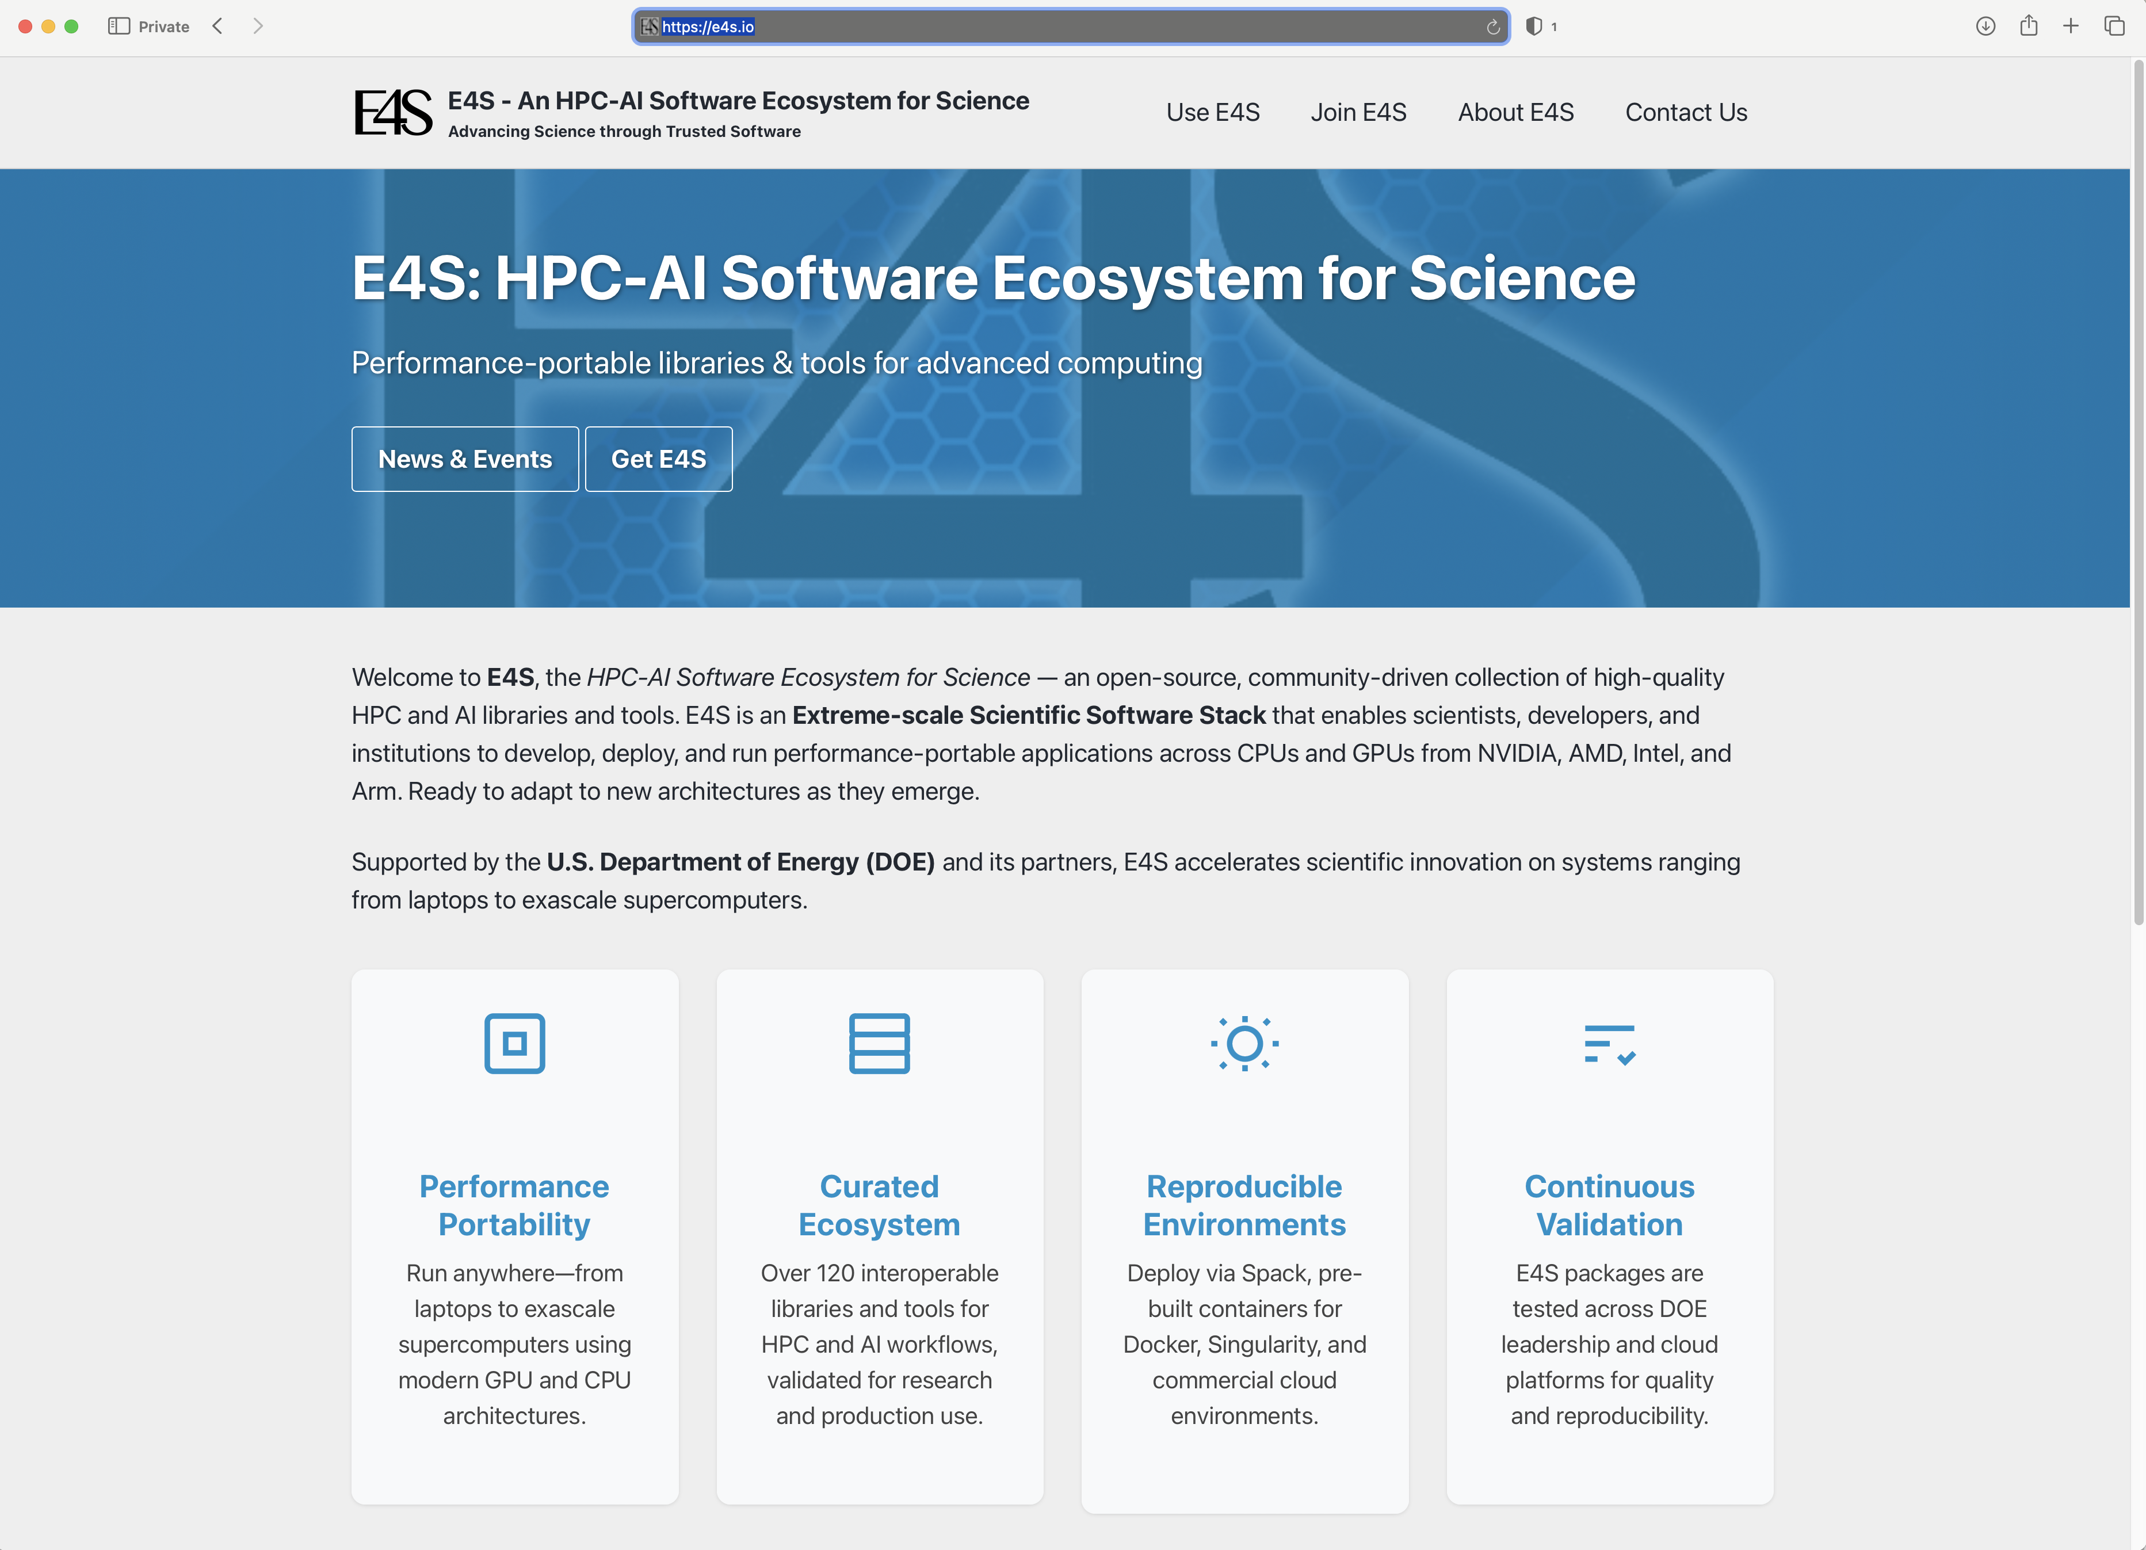
Updated E4S website https://e4s.io

Slide 6
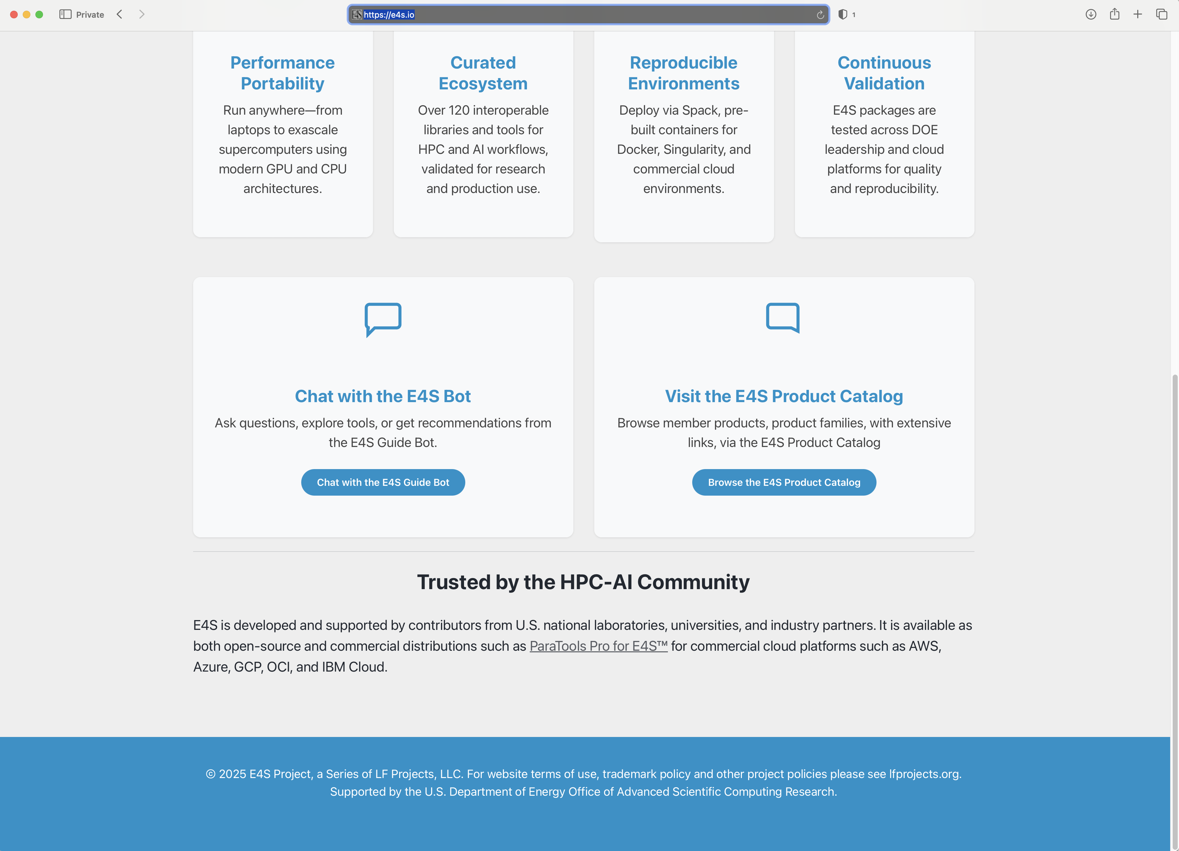
Chatbot integration in E4S Website

Slide 7
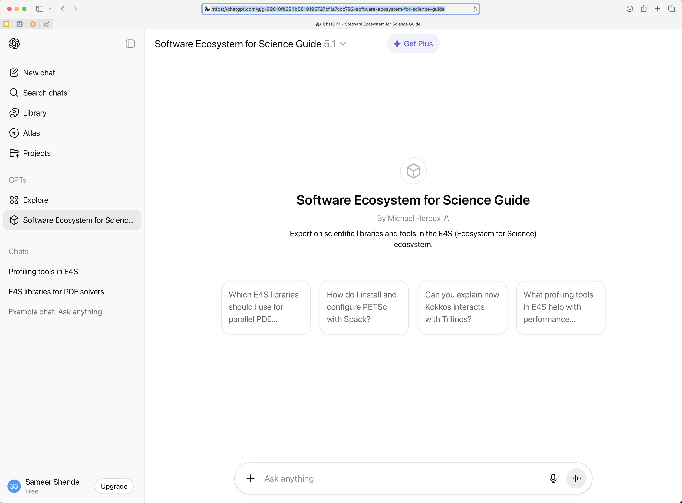
Chatbot integration in E4S Website

Slide 8
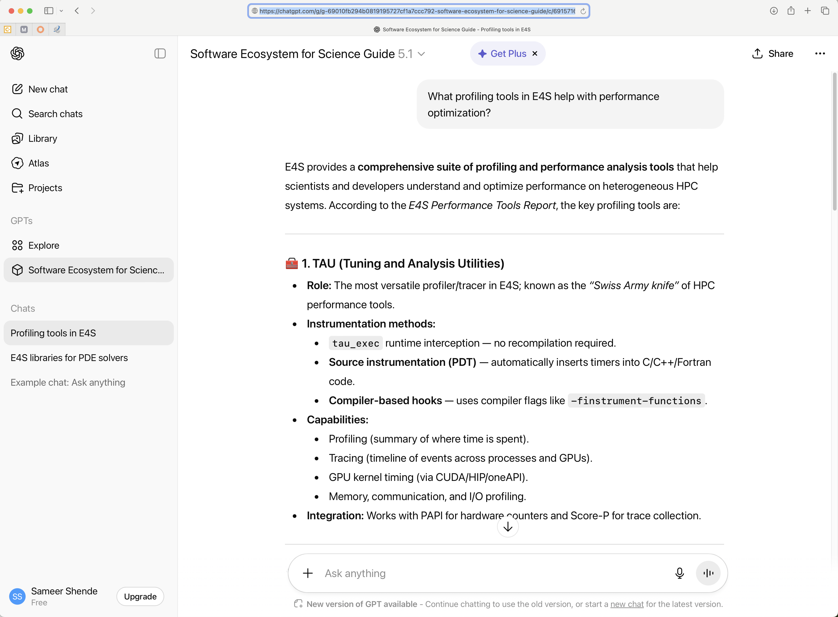
E4S Bot trained on E4S content on OpenAI’s ChatGPT

Slide 9
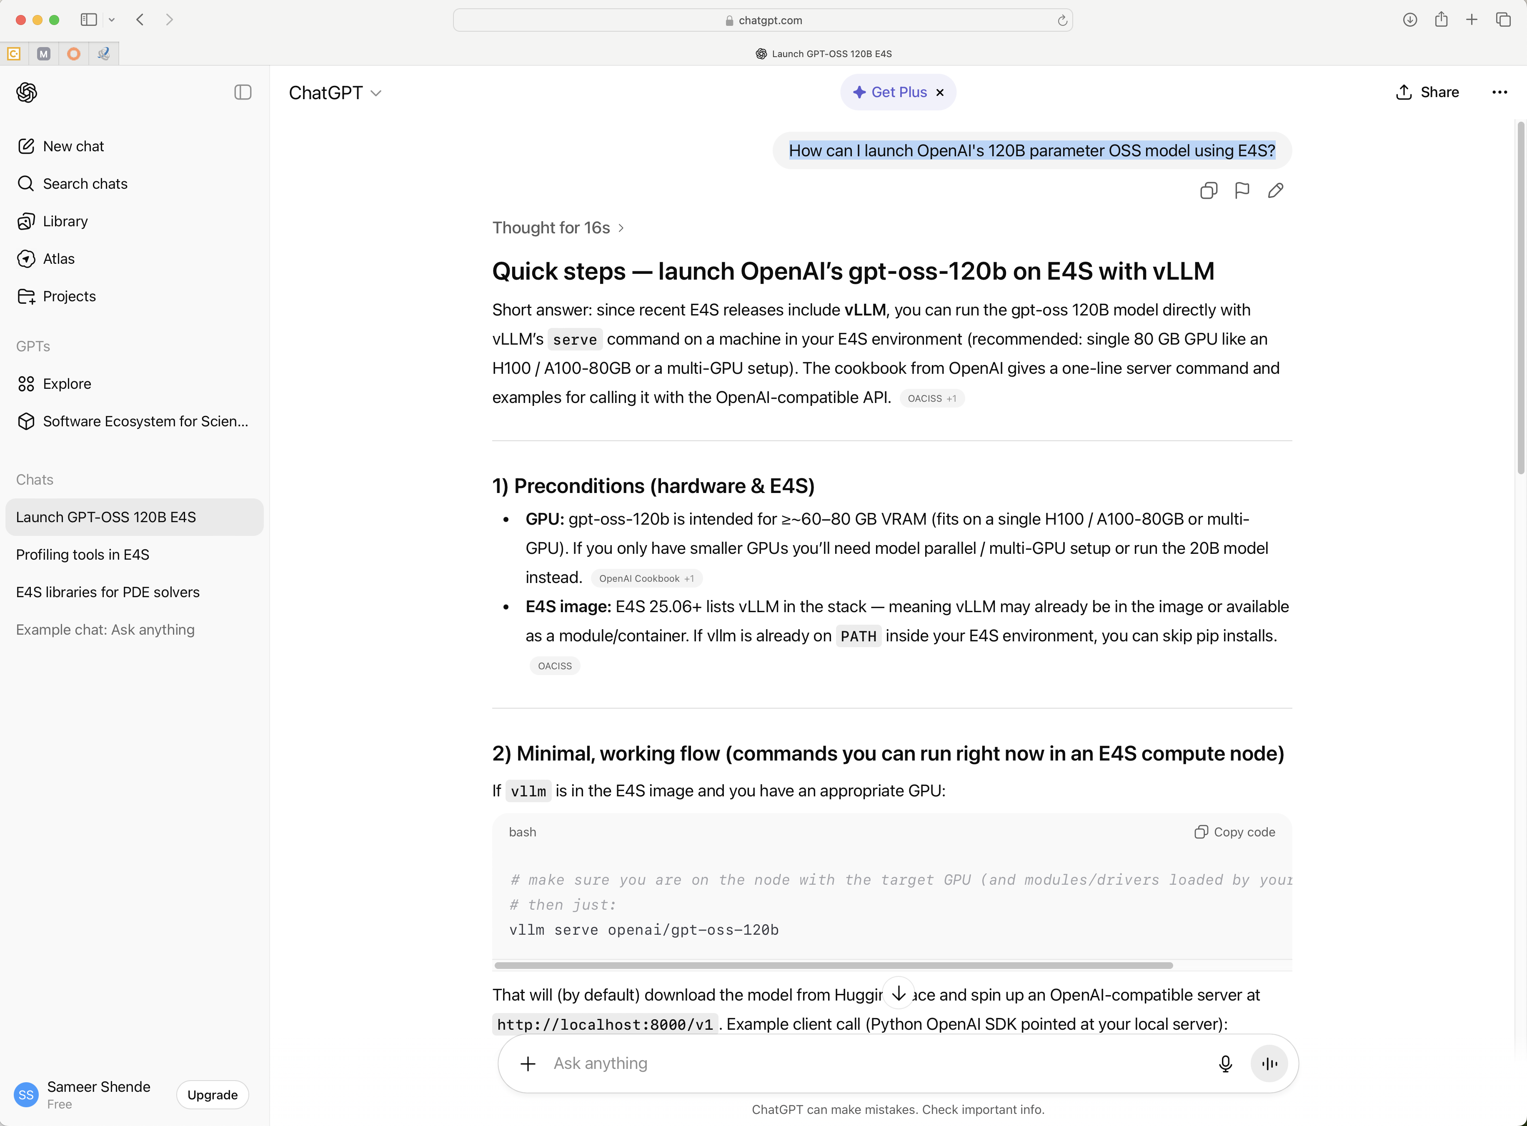
E4S Bot

Slide 10
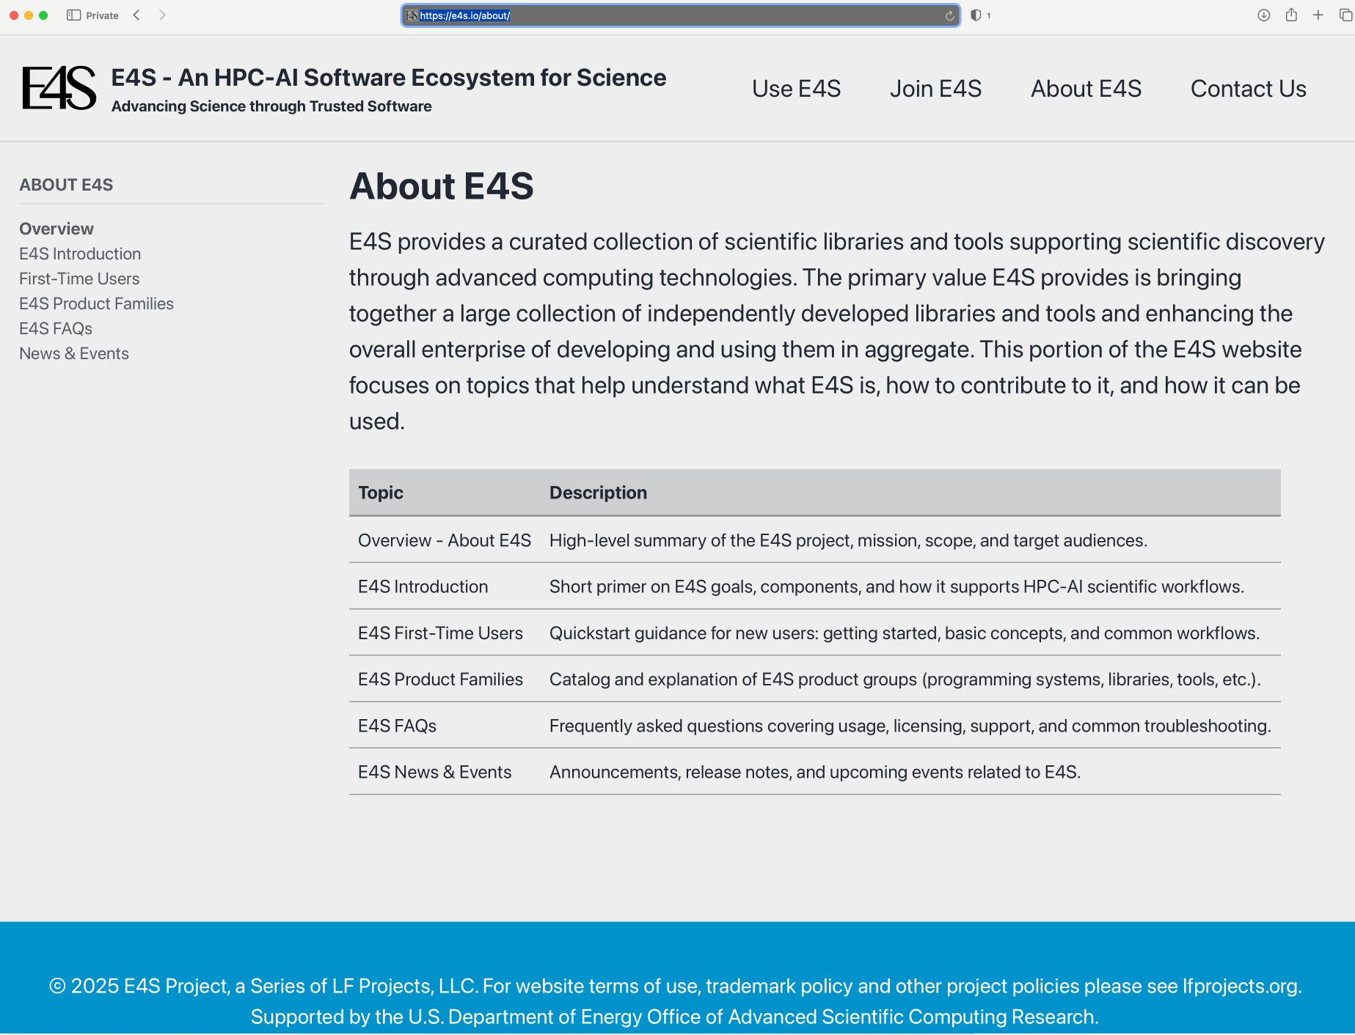
E4S Documentation

Slide 11
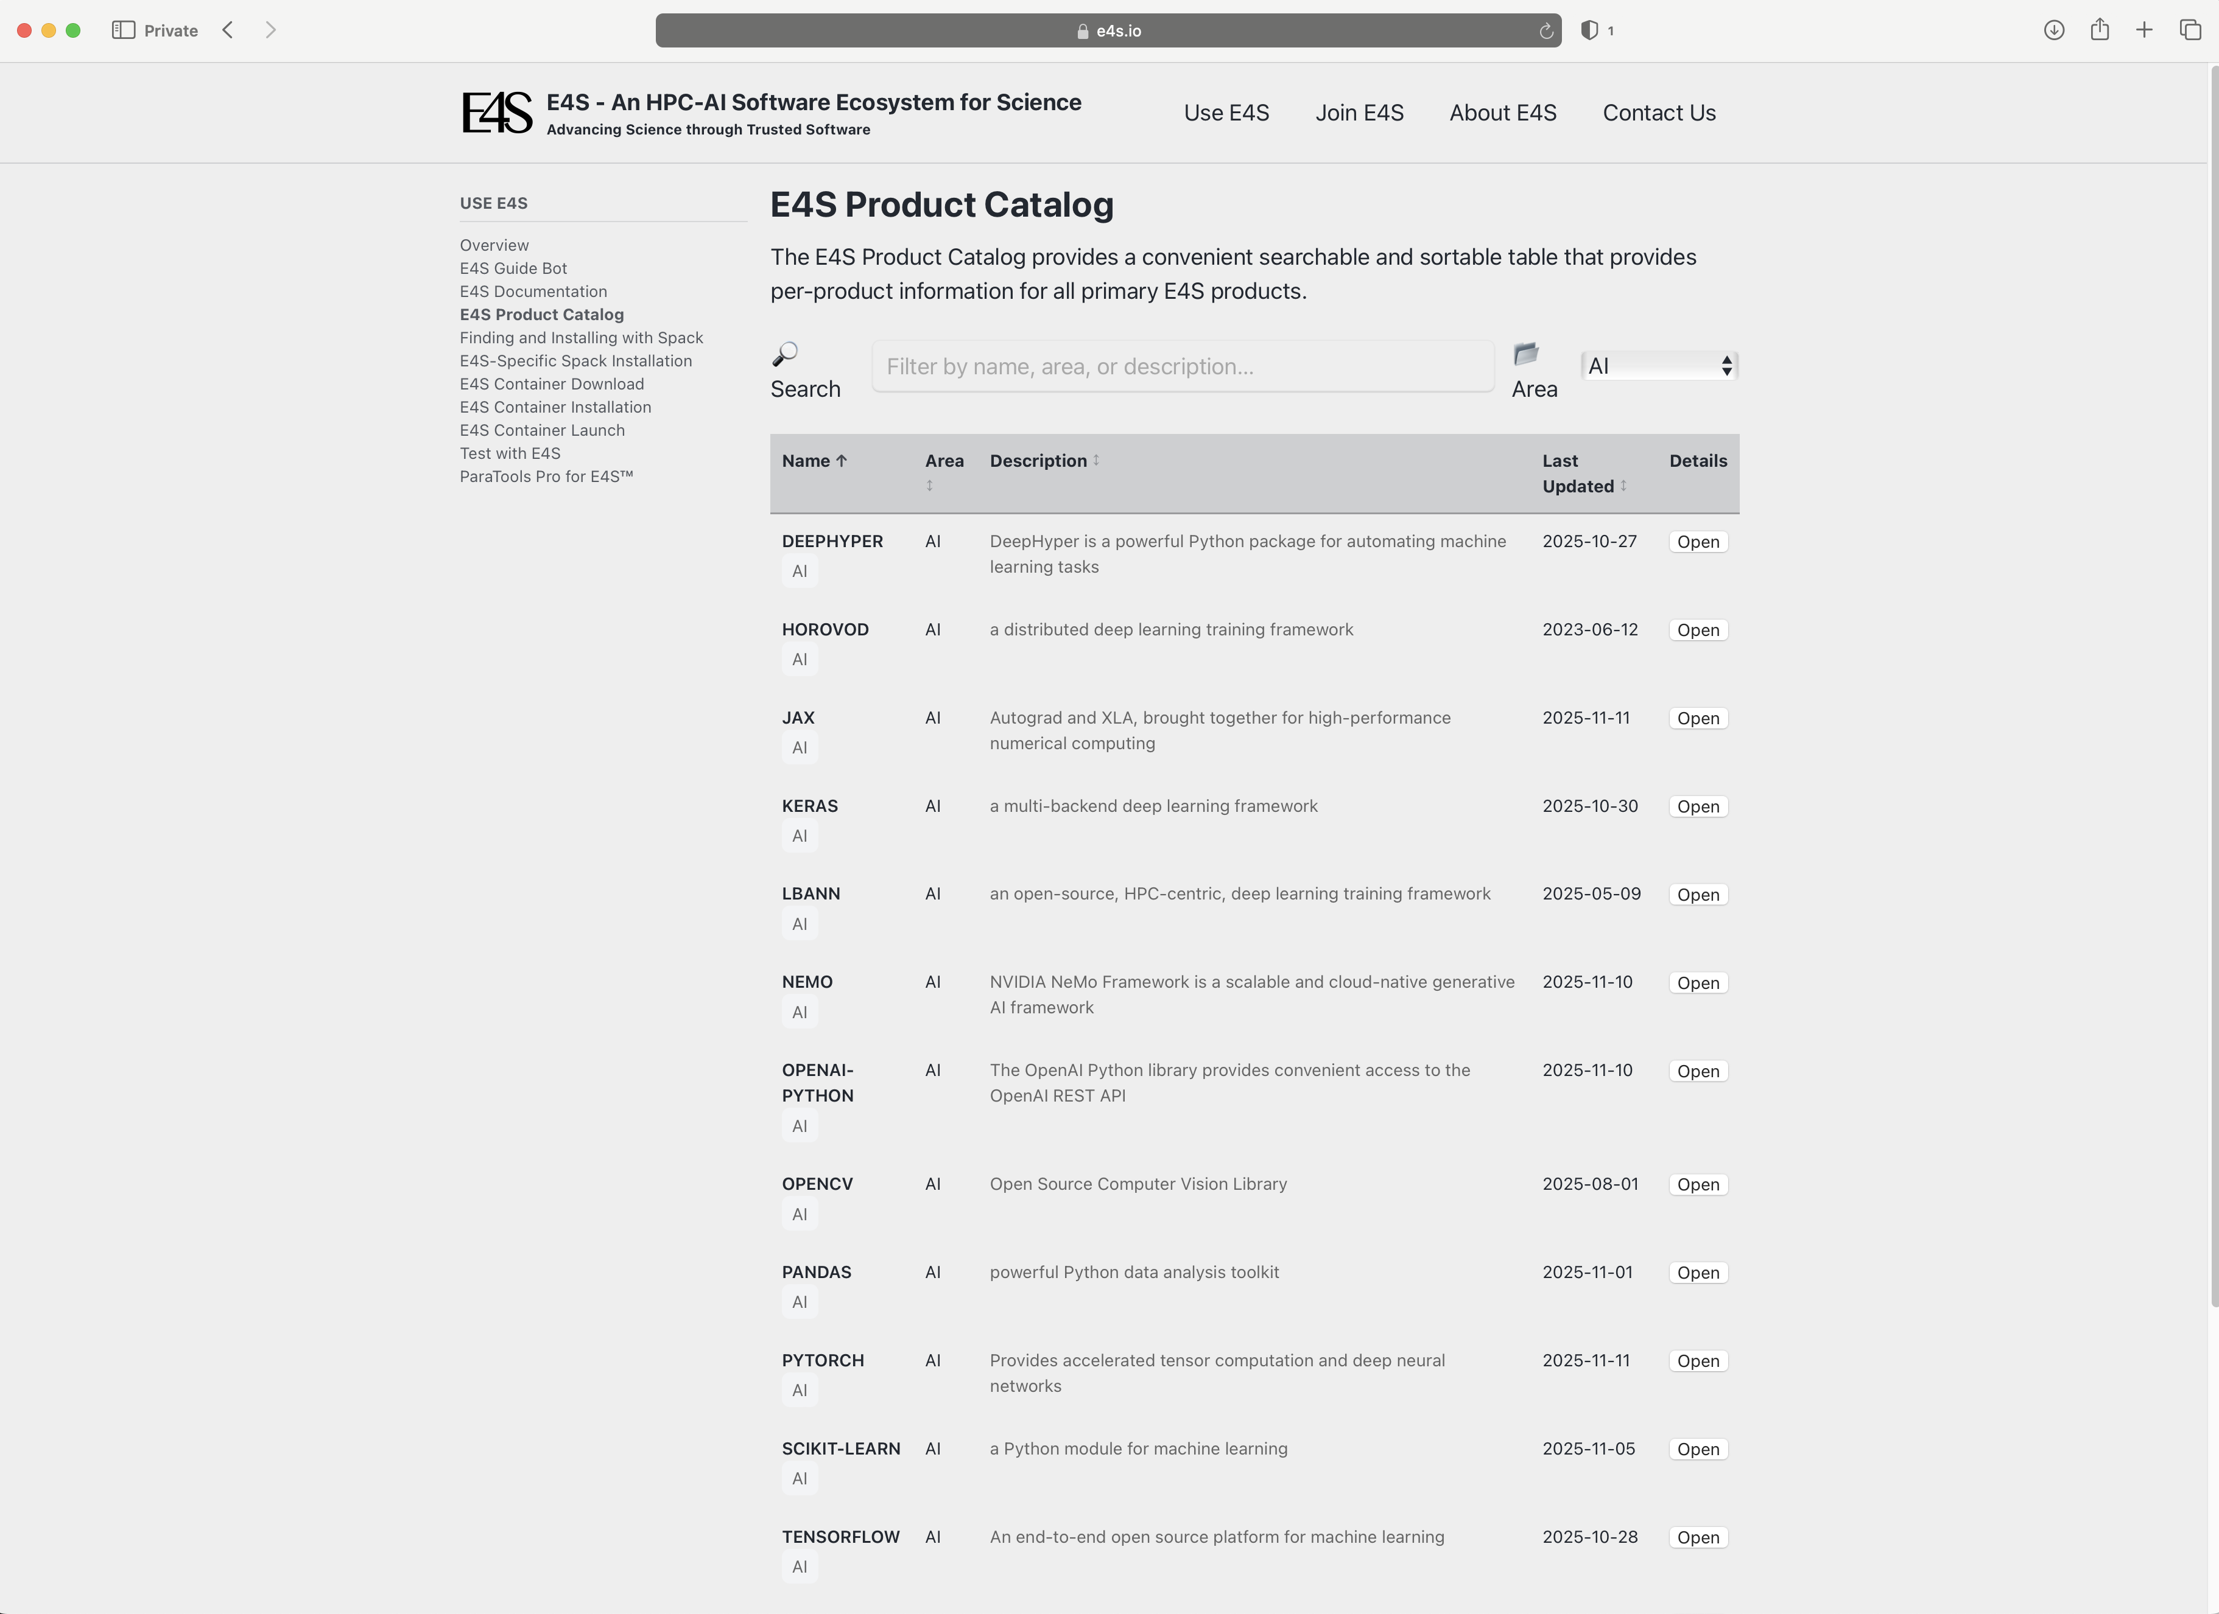
E4S Product Catalog

Slide 12
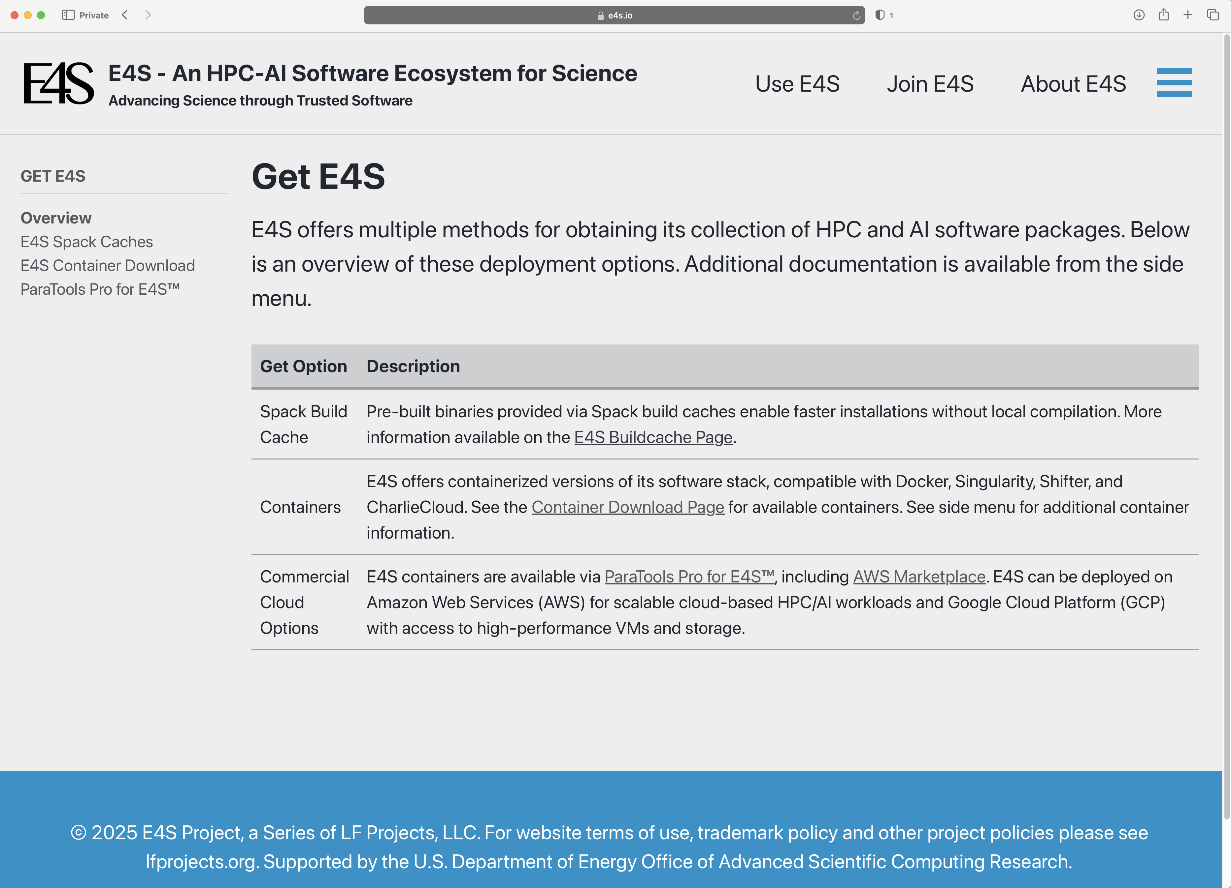
E4S: Bare-metal installation, Containers, and Cloud images

Slide 13
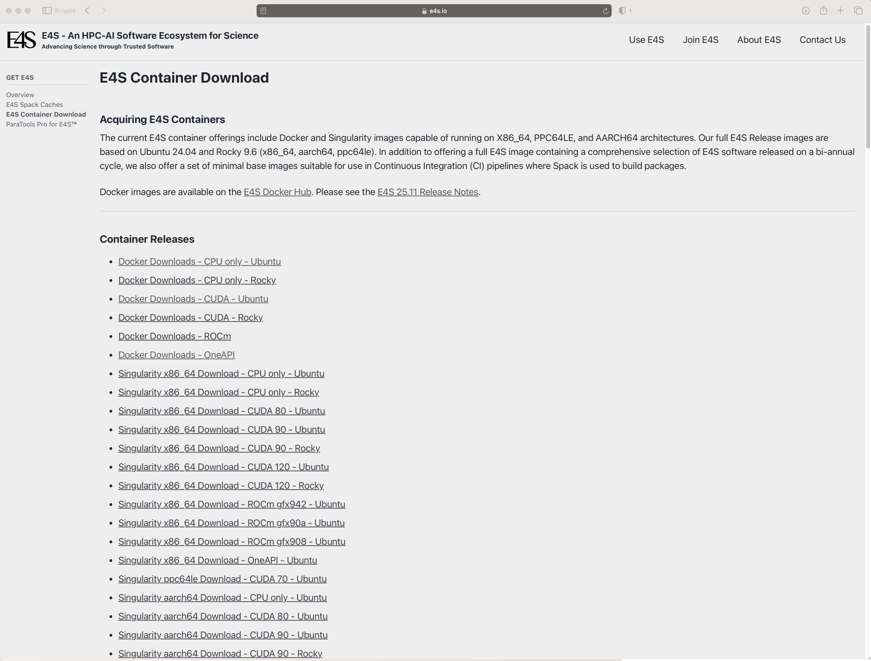
Download E4S Containers: Rocky Linux 9.6 and Ubuntu 24.04 LTS
Docker and Singularity
ARM64 (aarch64), x86_64, and ppc64le
Support for GPUS:
NVIDIA
AMD
Intel
GPU Runtimes:
CUDA 12.9
ROCm 6.4.3
oneAPI 2025.2
Languages:
C/C++/Fortran
Python
Rust
Julia
Chapel ...
OSes:
Rocky Linux 9.6
Ubuntu 24.04 LTS

Slide 14
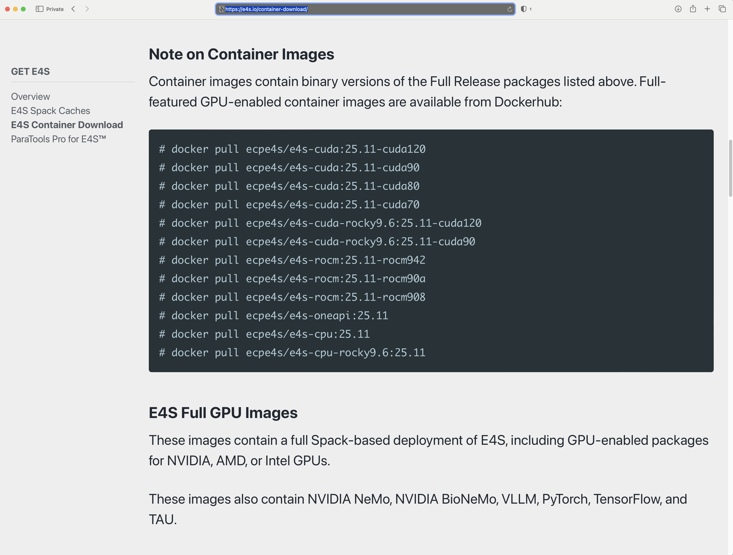
E4S container images available on DockerHub

Slide 15
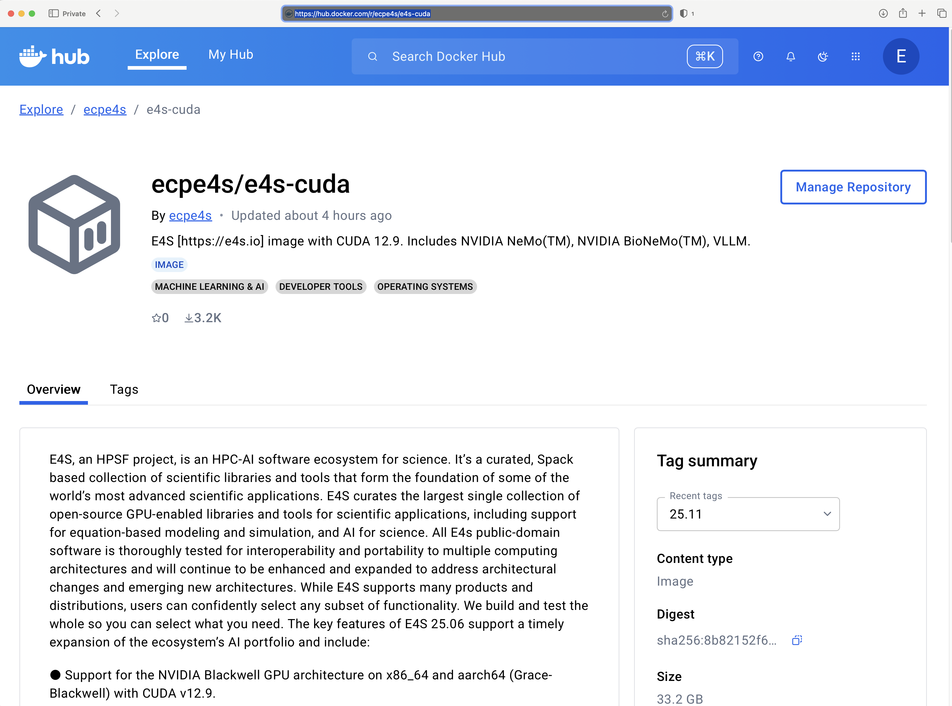
E4S 25.11 container images available on DockerHub

Slide 16
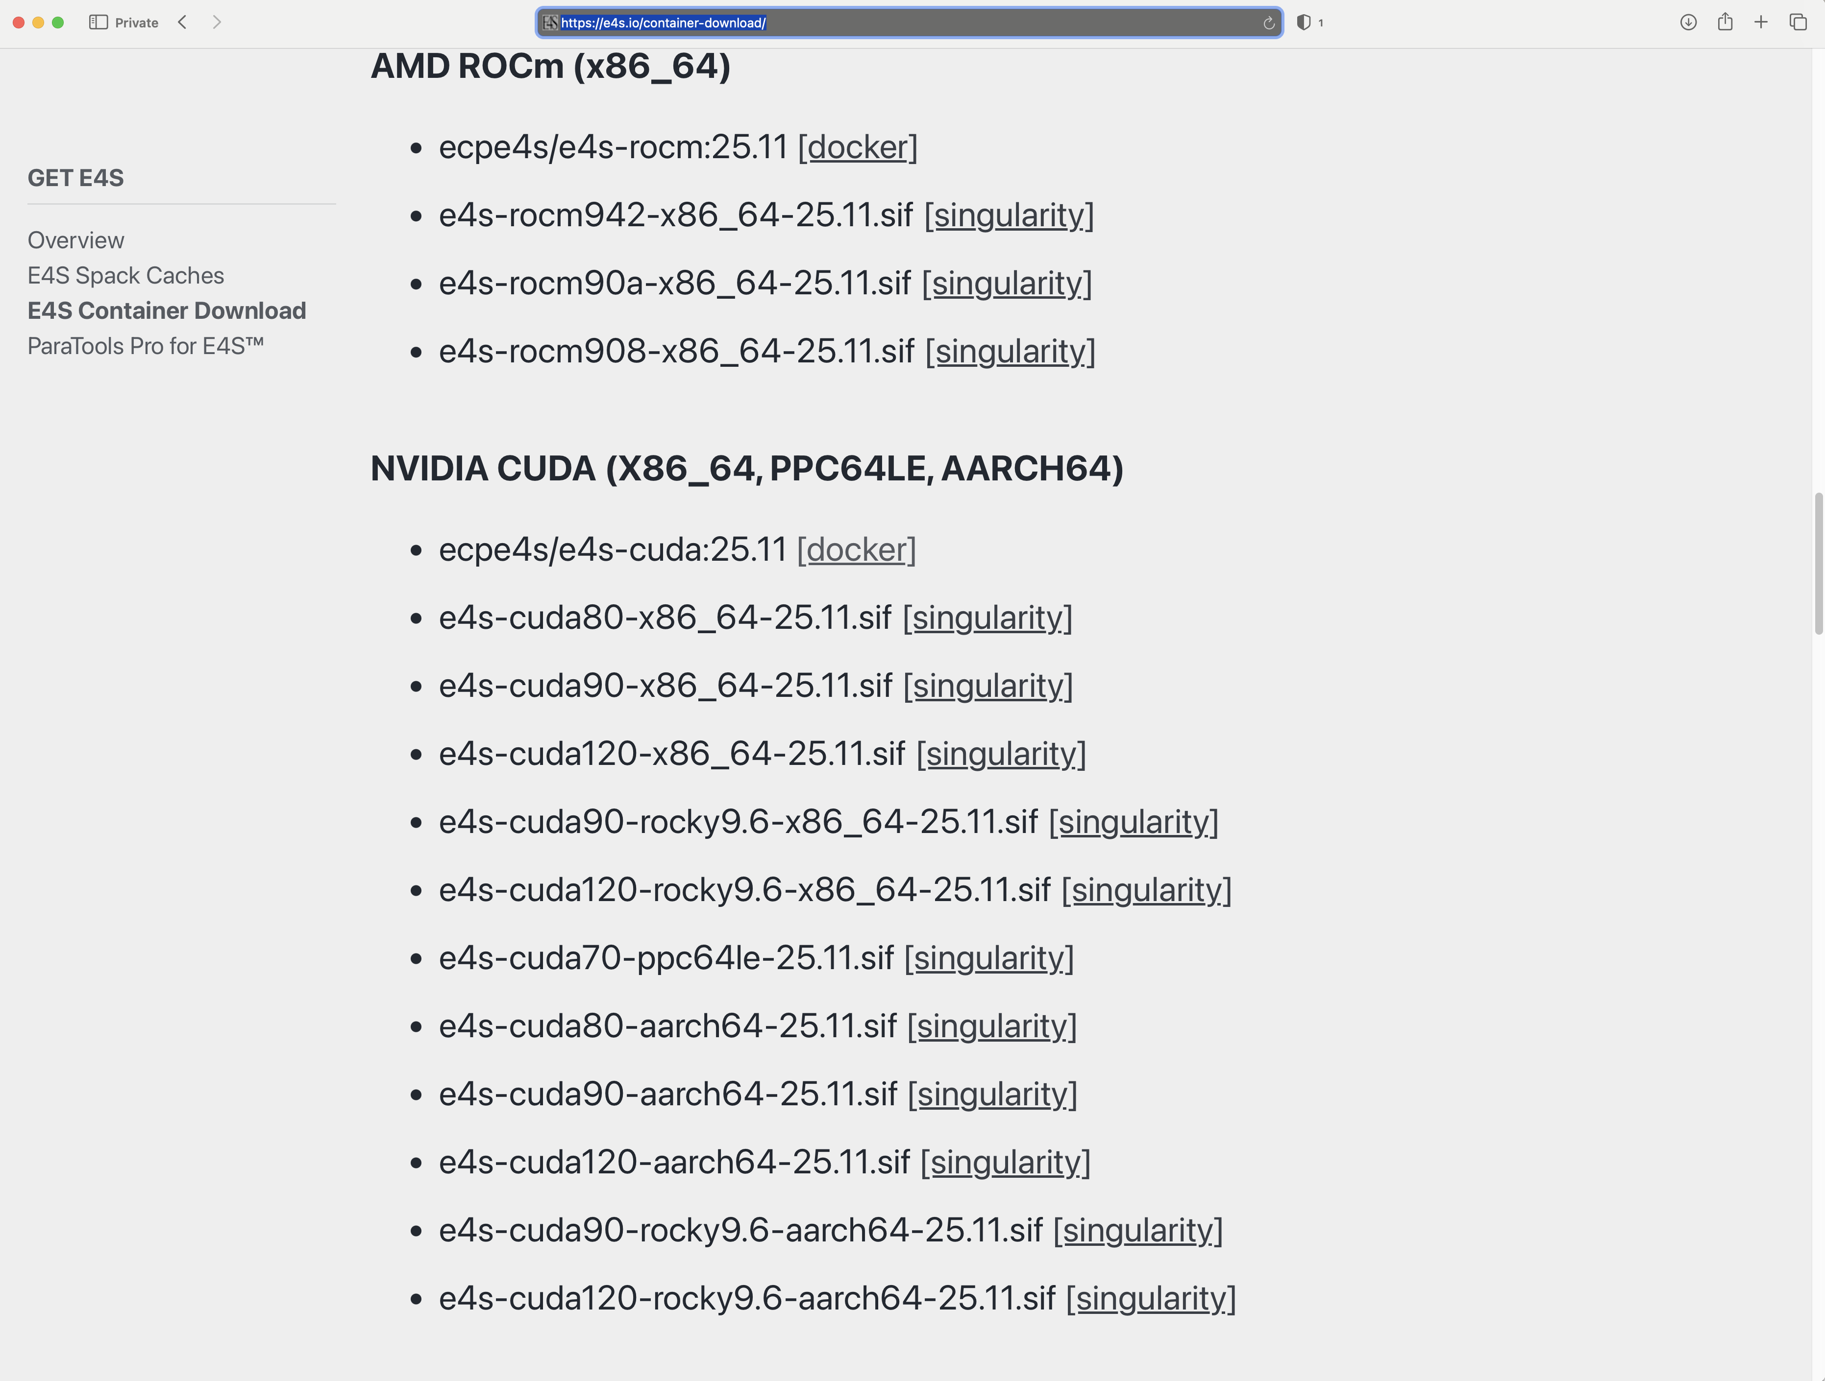
Download E4S containers: NVIDIA and AMD GPUs

Slide 17
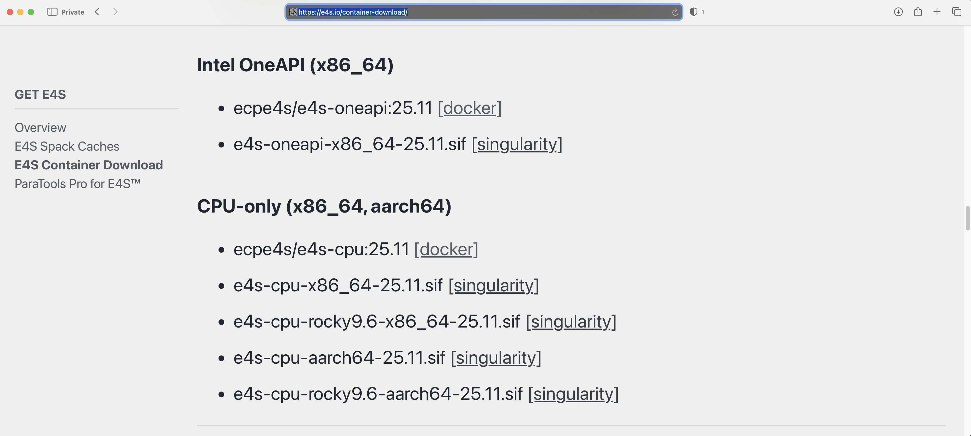
E4S Containers: Intel oneAPI (CPU/GPU) and CPU only

Slide 18
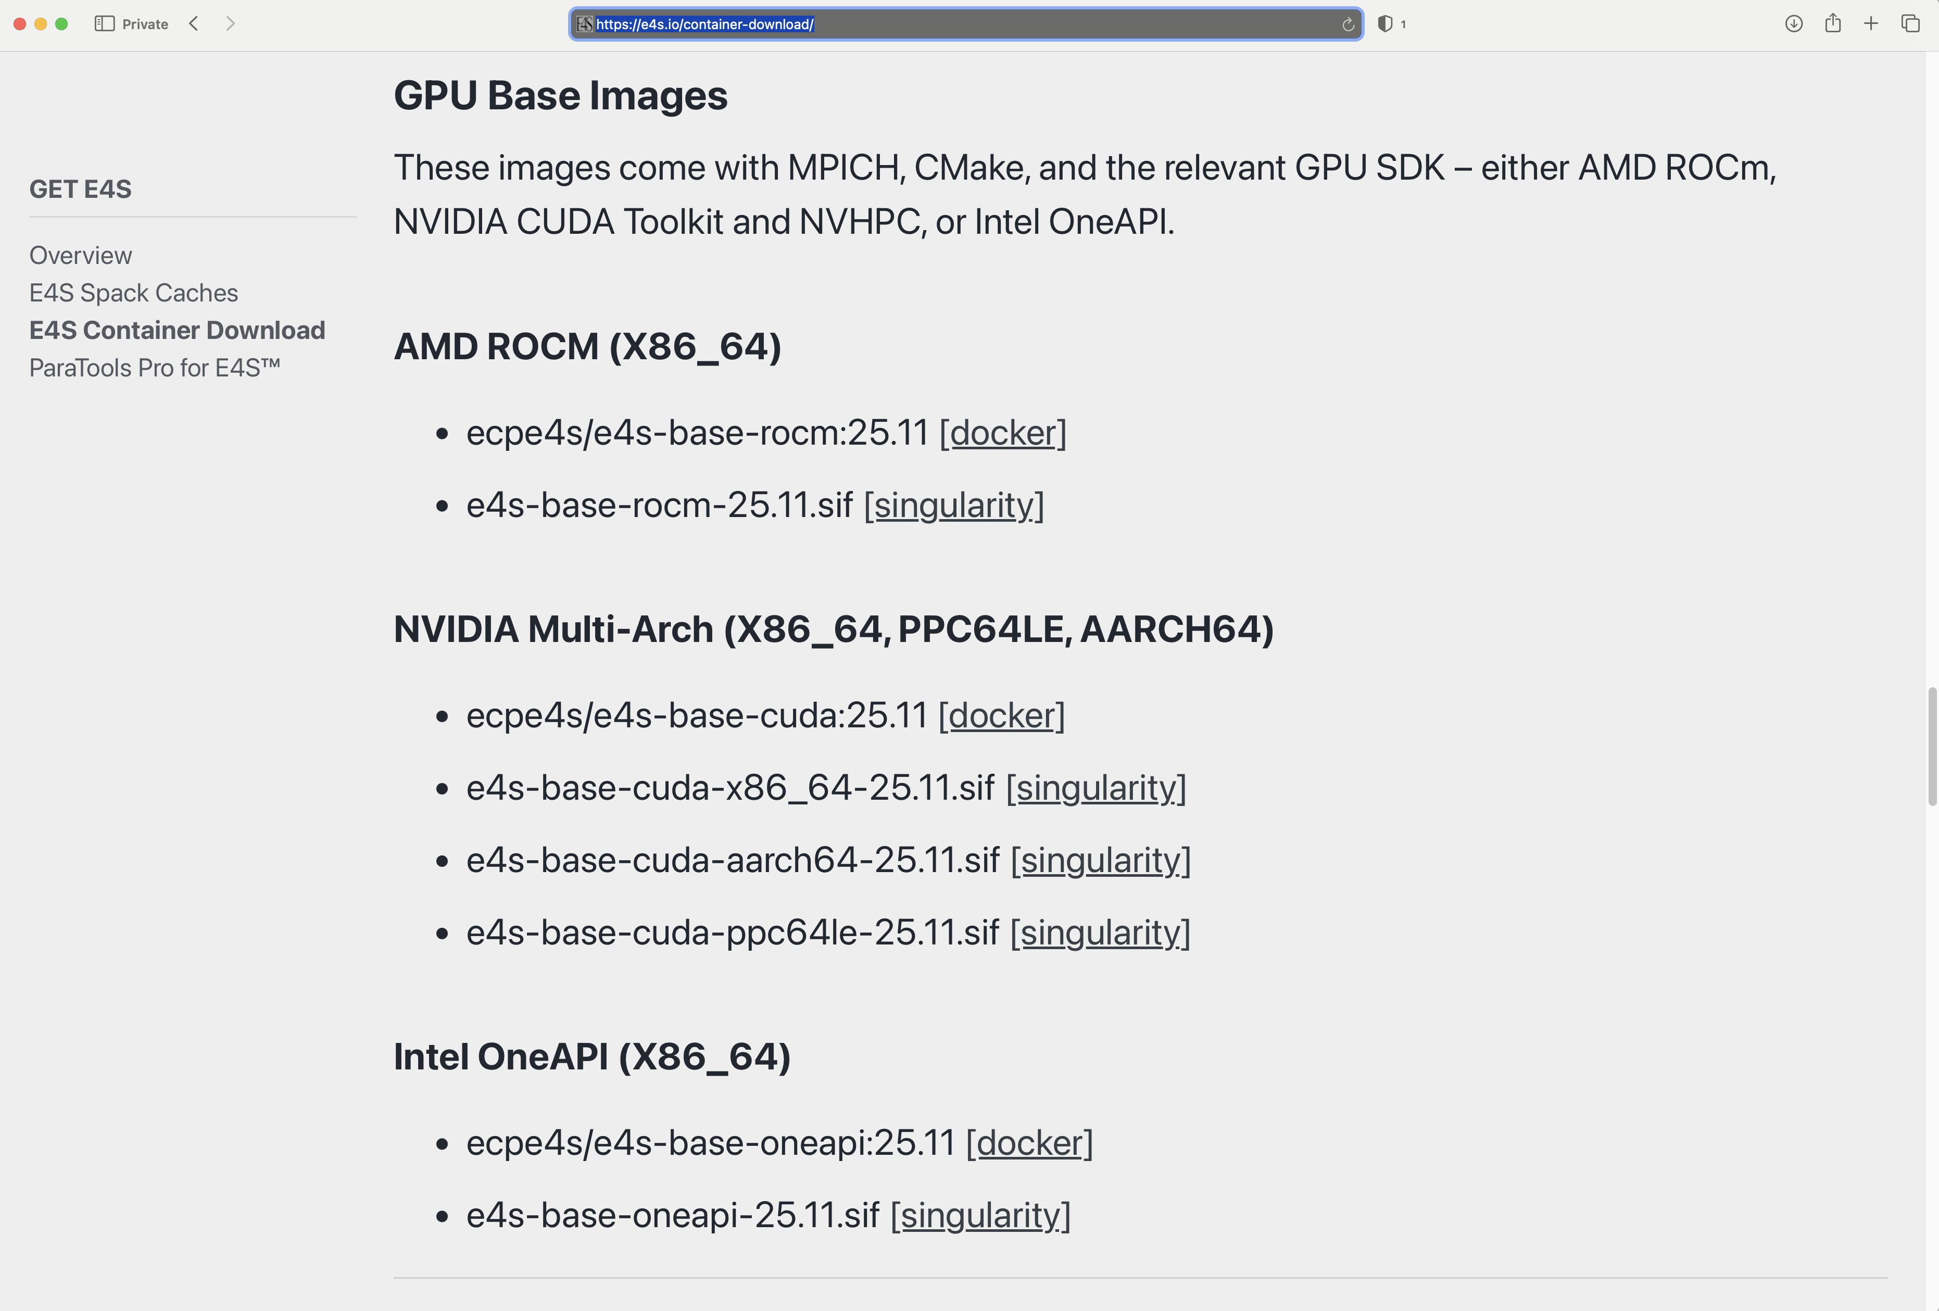
E4S Base Containers with GPU runtimes and MPI

Slide 19
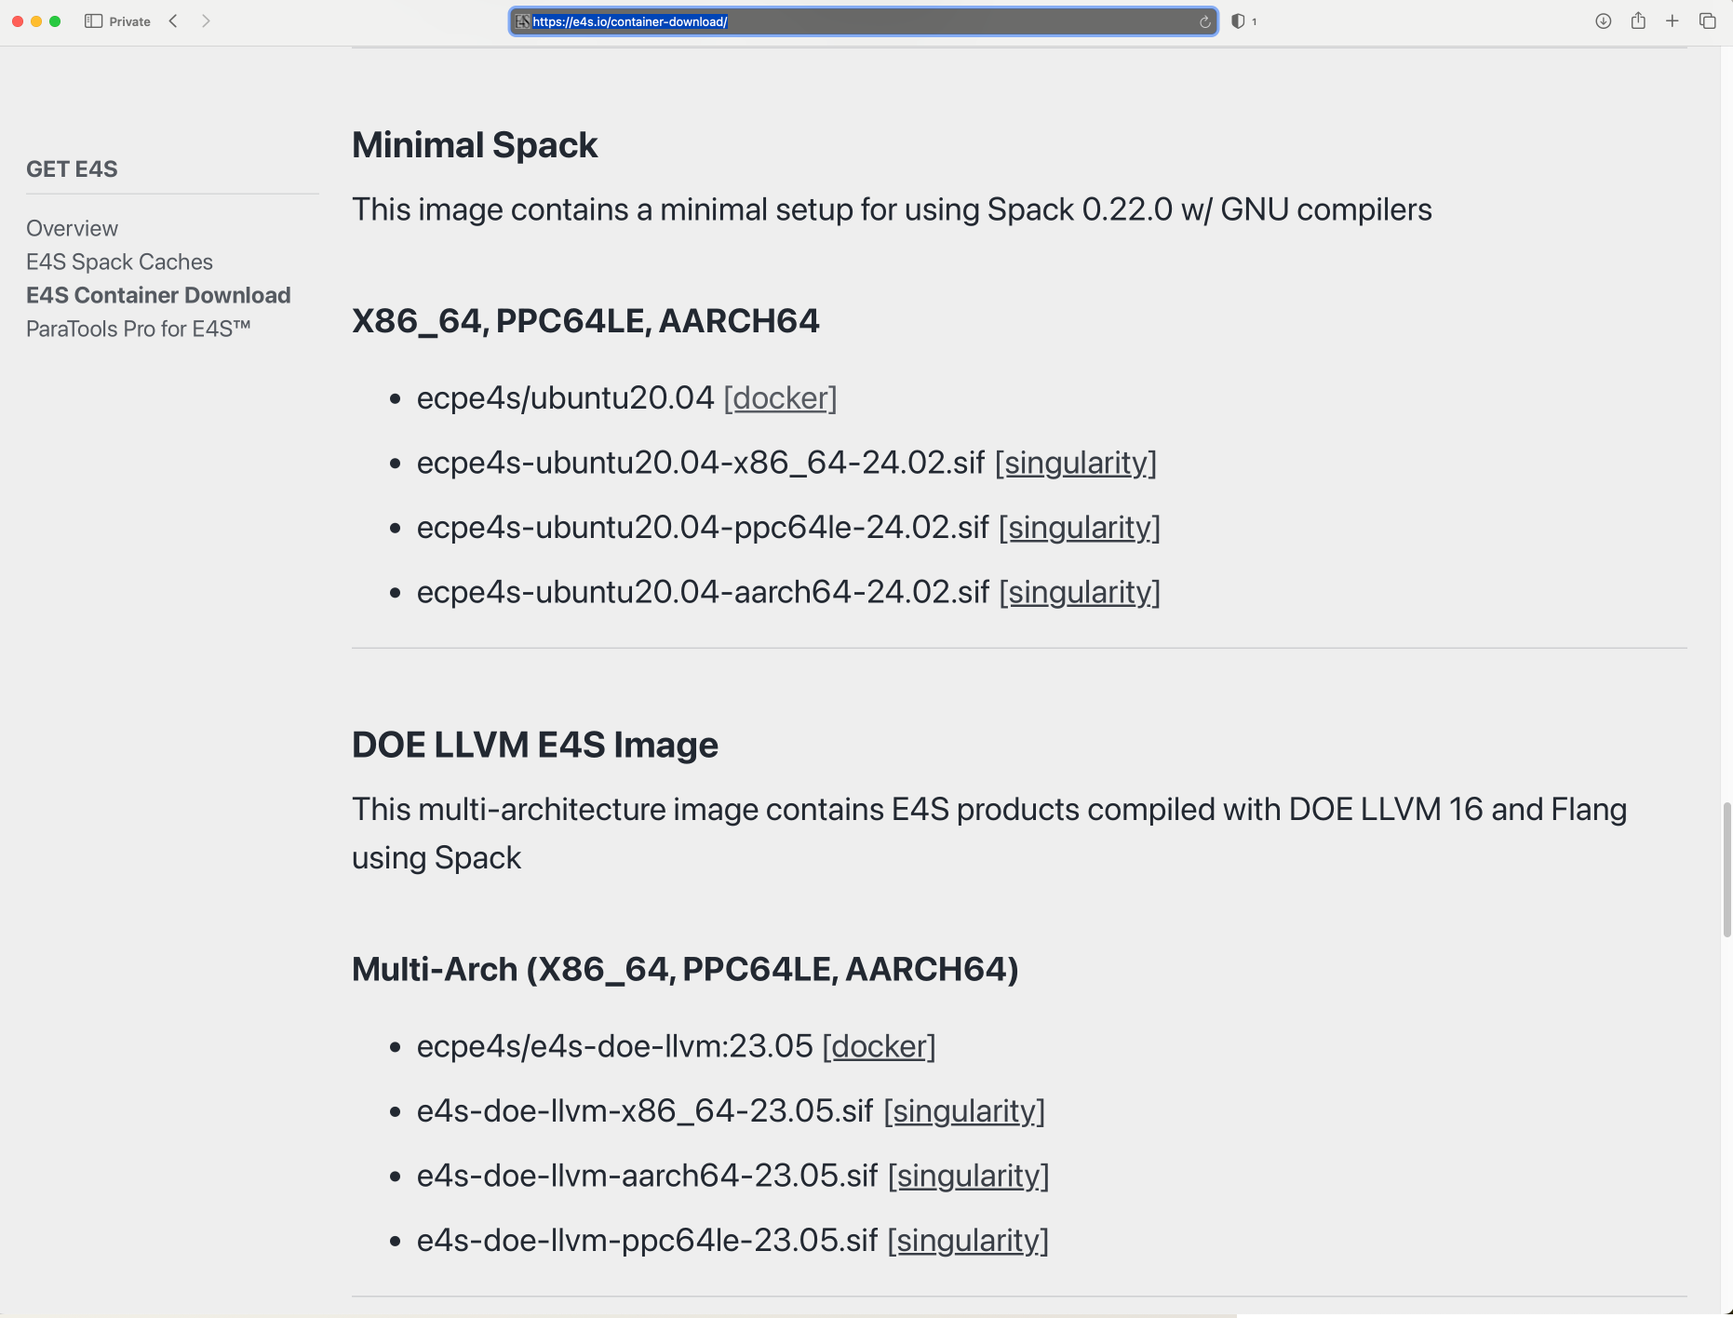
Minimal E4S Spack containers

Slide 20
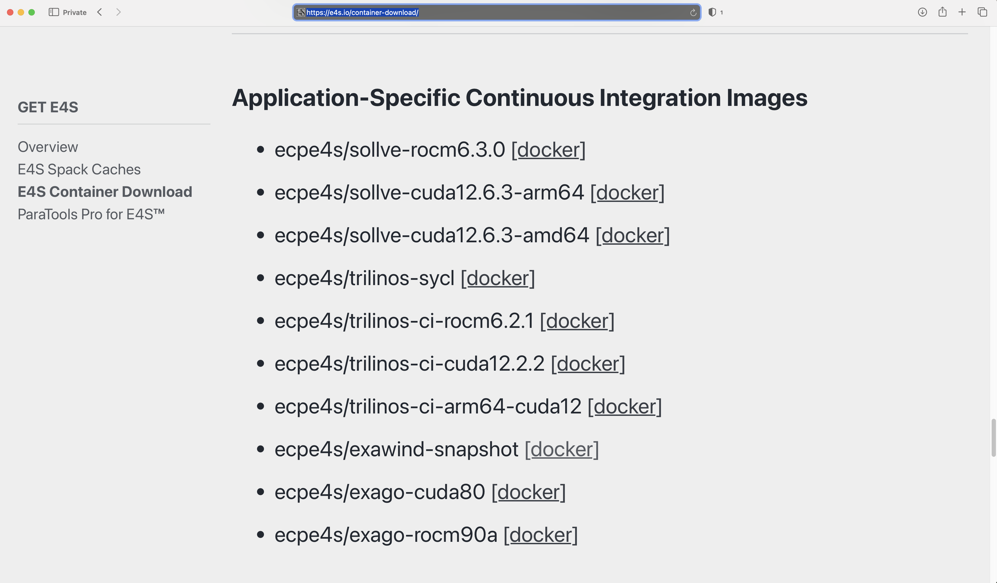
E4S Application Specific Container Images for CI: Customization

Slide 21
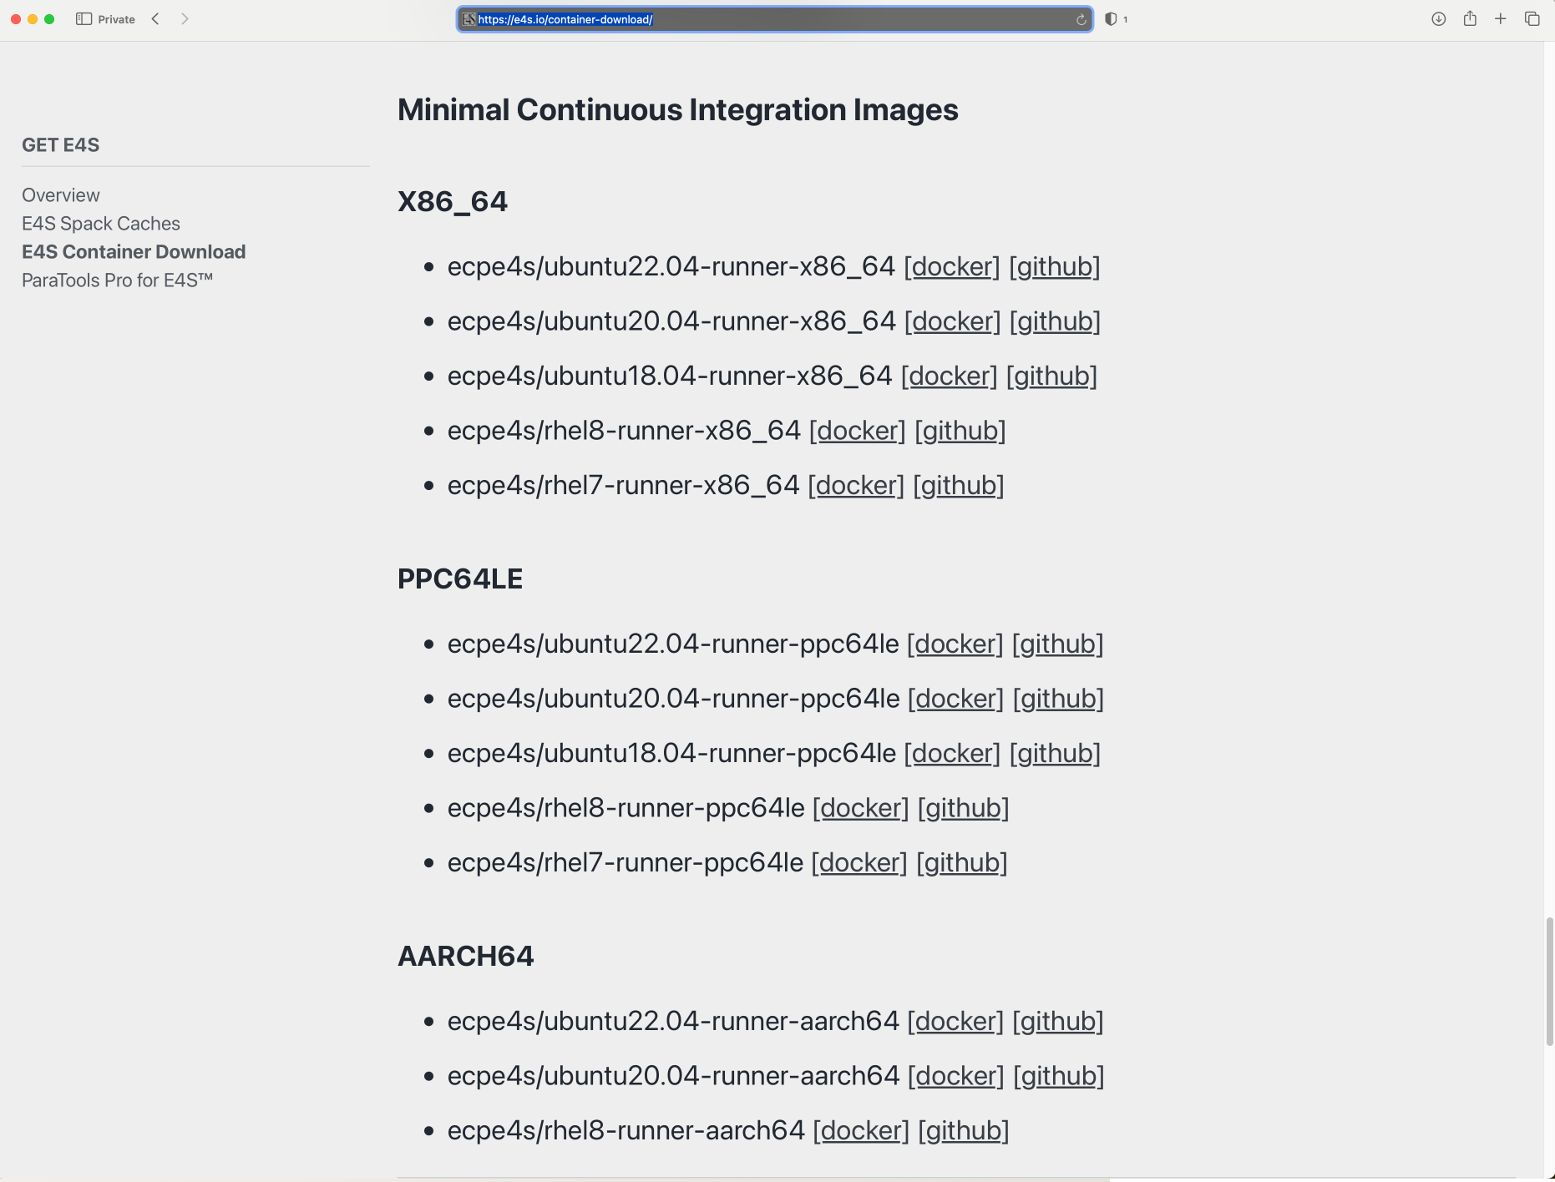
E4S Container Images for CI: Gitlab Runners

Slide 22
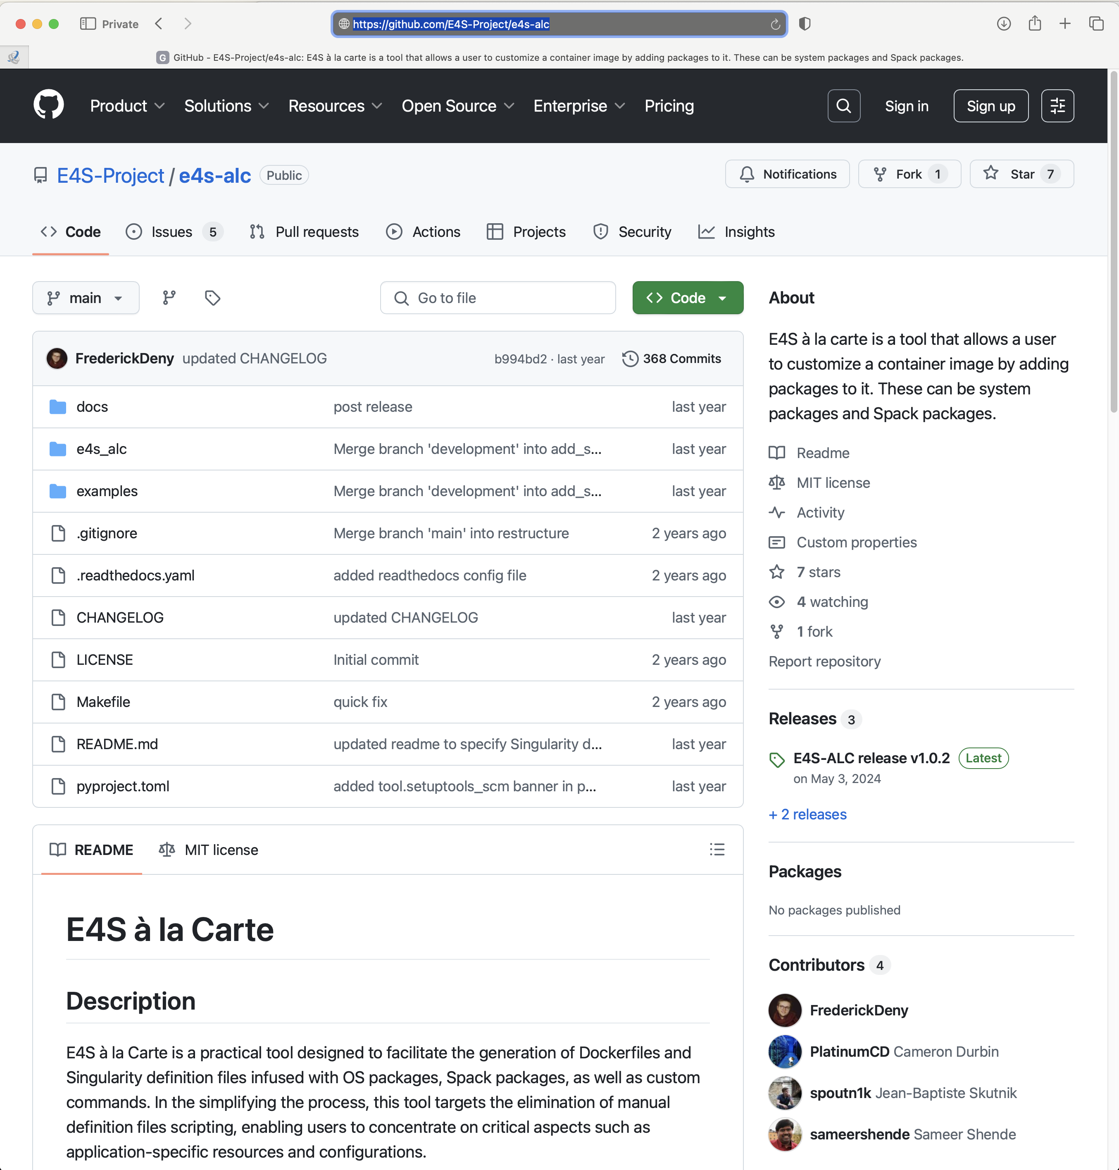
E4S Tools: E4S à la carte or e4s-alc: Customize container images
Add new system packages
Add new Spack packages
Add new tarballs
Customize the container image
Start with a base image
Add packages
Create a new container image!
https://github.com/E4s-Project/e4s-alc
Notes:
quick run through - what ECP ST is working on

Slide 23
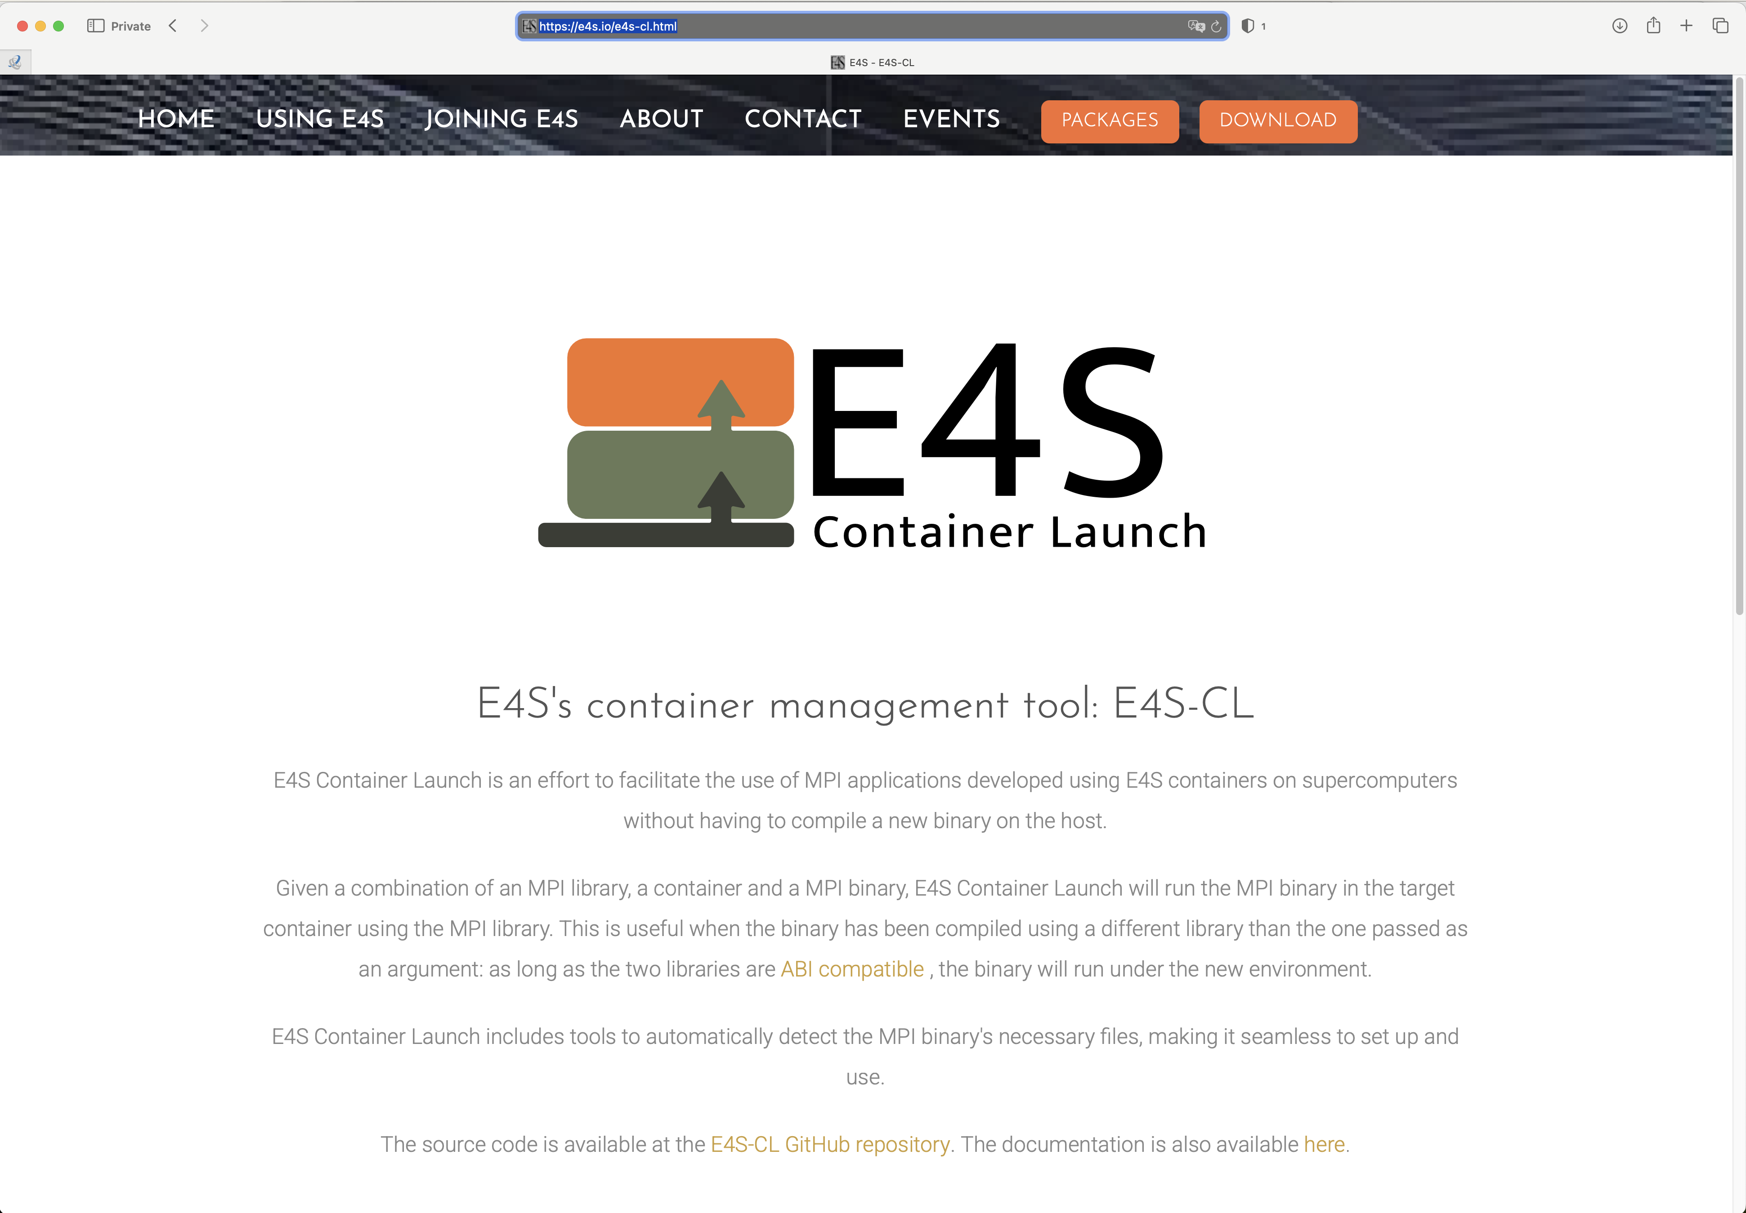
E4S Tools: e4s-cl: Container Launch tool for MPI applications
Distribute your MPI application as a binary with an E4S image
While deploying on a system substitute the embedded containerized MPI in application with the system/vendor MPI
Use inter-node network interfaces efficiently for near native performance!
https://e4s.io/e4s-cl.html
Notes:
quick run through - what ECP ST is working on

Slide 24

e4s-cl: A tool to simplify the launch of MPI jobs in E4S containers
E4S containers support replacement of MPI libraries using MPICH ABI compatibility layer and Wi4MPI [CEA] for OpenMPI replacement.
Applications binaries built using E4S can be launched with Singularity using MPI library substitution for efficient inter-node communications.
e4s-cl is a new tool that simplifies the launch and MPI replacement.
e4s-cl init --backend [singularity|shifter|docker] --image <file> --source <startup_cmds.sh>
e4s-cl srun -n <N> <command>
Usage:
% e4s-cl init --backend singularity --image ~/images/e4s-gpu-x86.sif --source ~/source.sh
% cat ~/source.sh
. /spack/share/spack/setup-env.sh
spack load trilinos+cuda
% e4s-cl srun -n 4 ./a.out
https://github.com/E4S-Project/e4s-cl
Notes:
quick run through - what ECP ST is working on

Slide 25
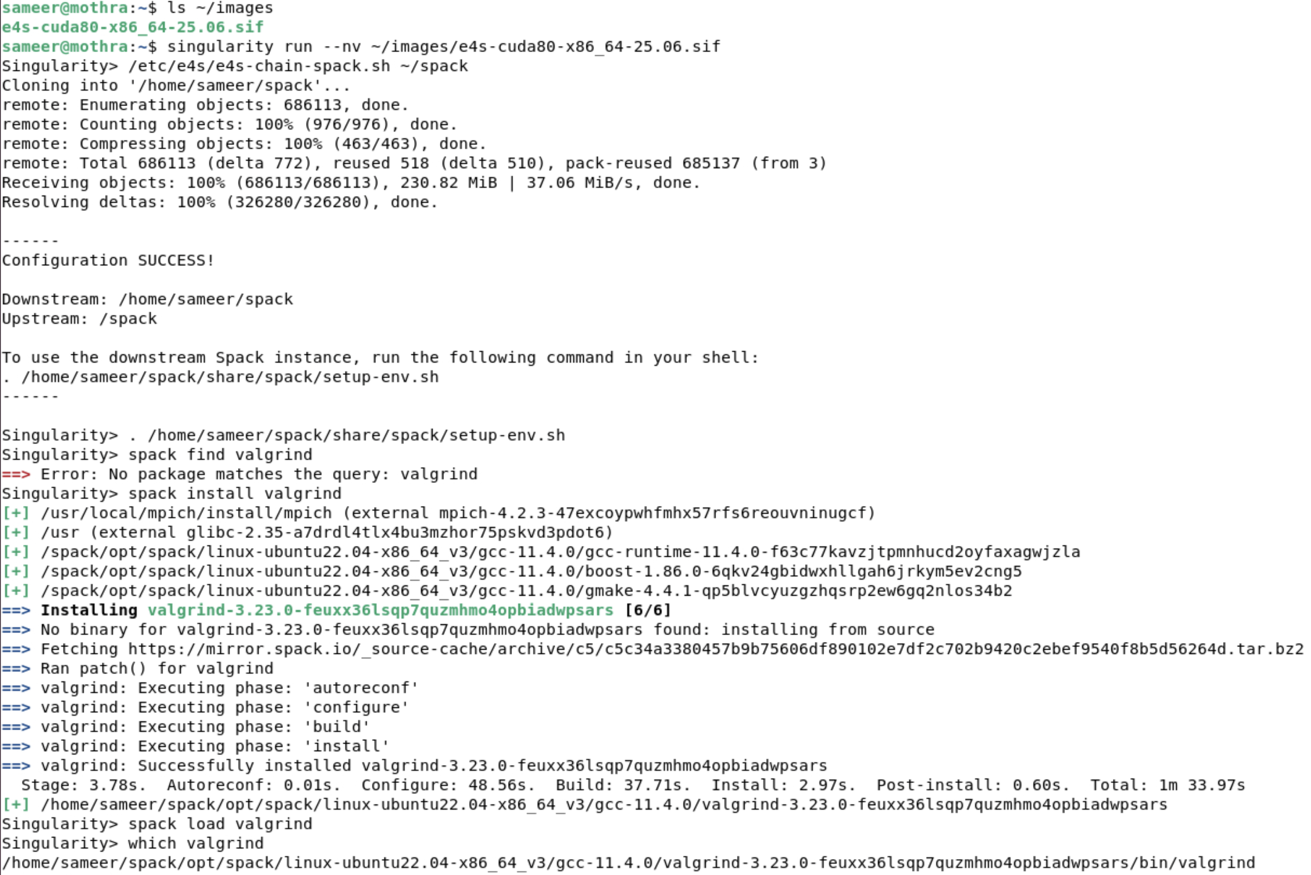
E4S Tools: e4s-chain-spack.sh to customize software stack
Specify location of downstream
Spack installation directory
Source downstream Spack’s setup-env.sh
Install a new Spack package
in downstream Spack directory
Load new package (valgrind)
using spack load
https://e4s.io
Notes:
quick run through - what ECP ST is working on

Slide 26
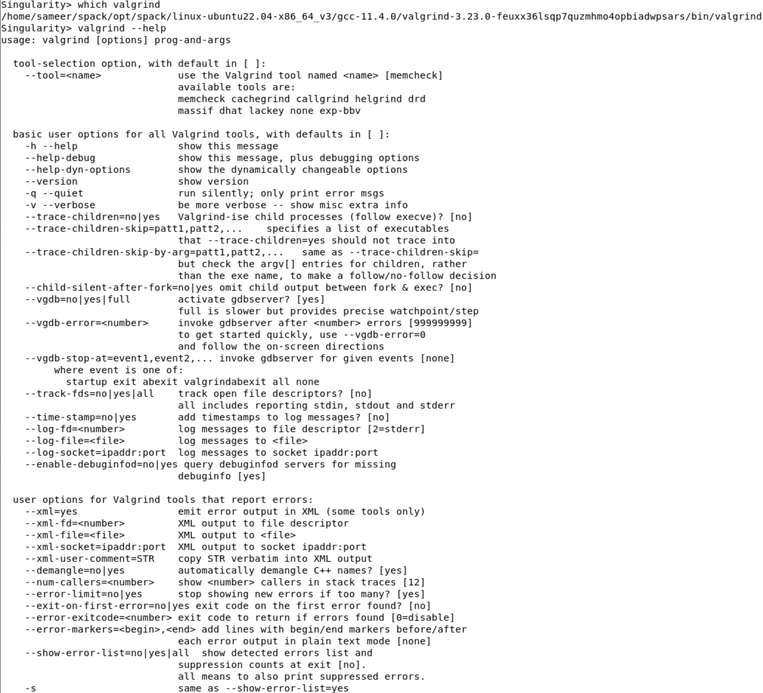
E4S Tools: e4s-chain-spack.sh to customize software stack
Downstream Spack’s package
is loaded in your environment
e4s-chain-spack.sh helps
customize the software stack
using upstream /spack (read-only in the container) for
package dependencies while
installing a new package in the
downstream Spack in your writable home directory.
https://e4s.io
Notes:
quick run through - what ECP ST is working on

Slide 27
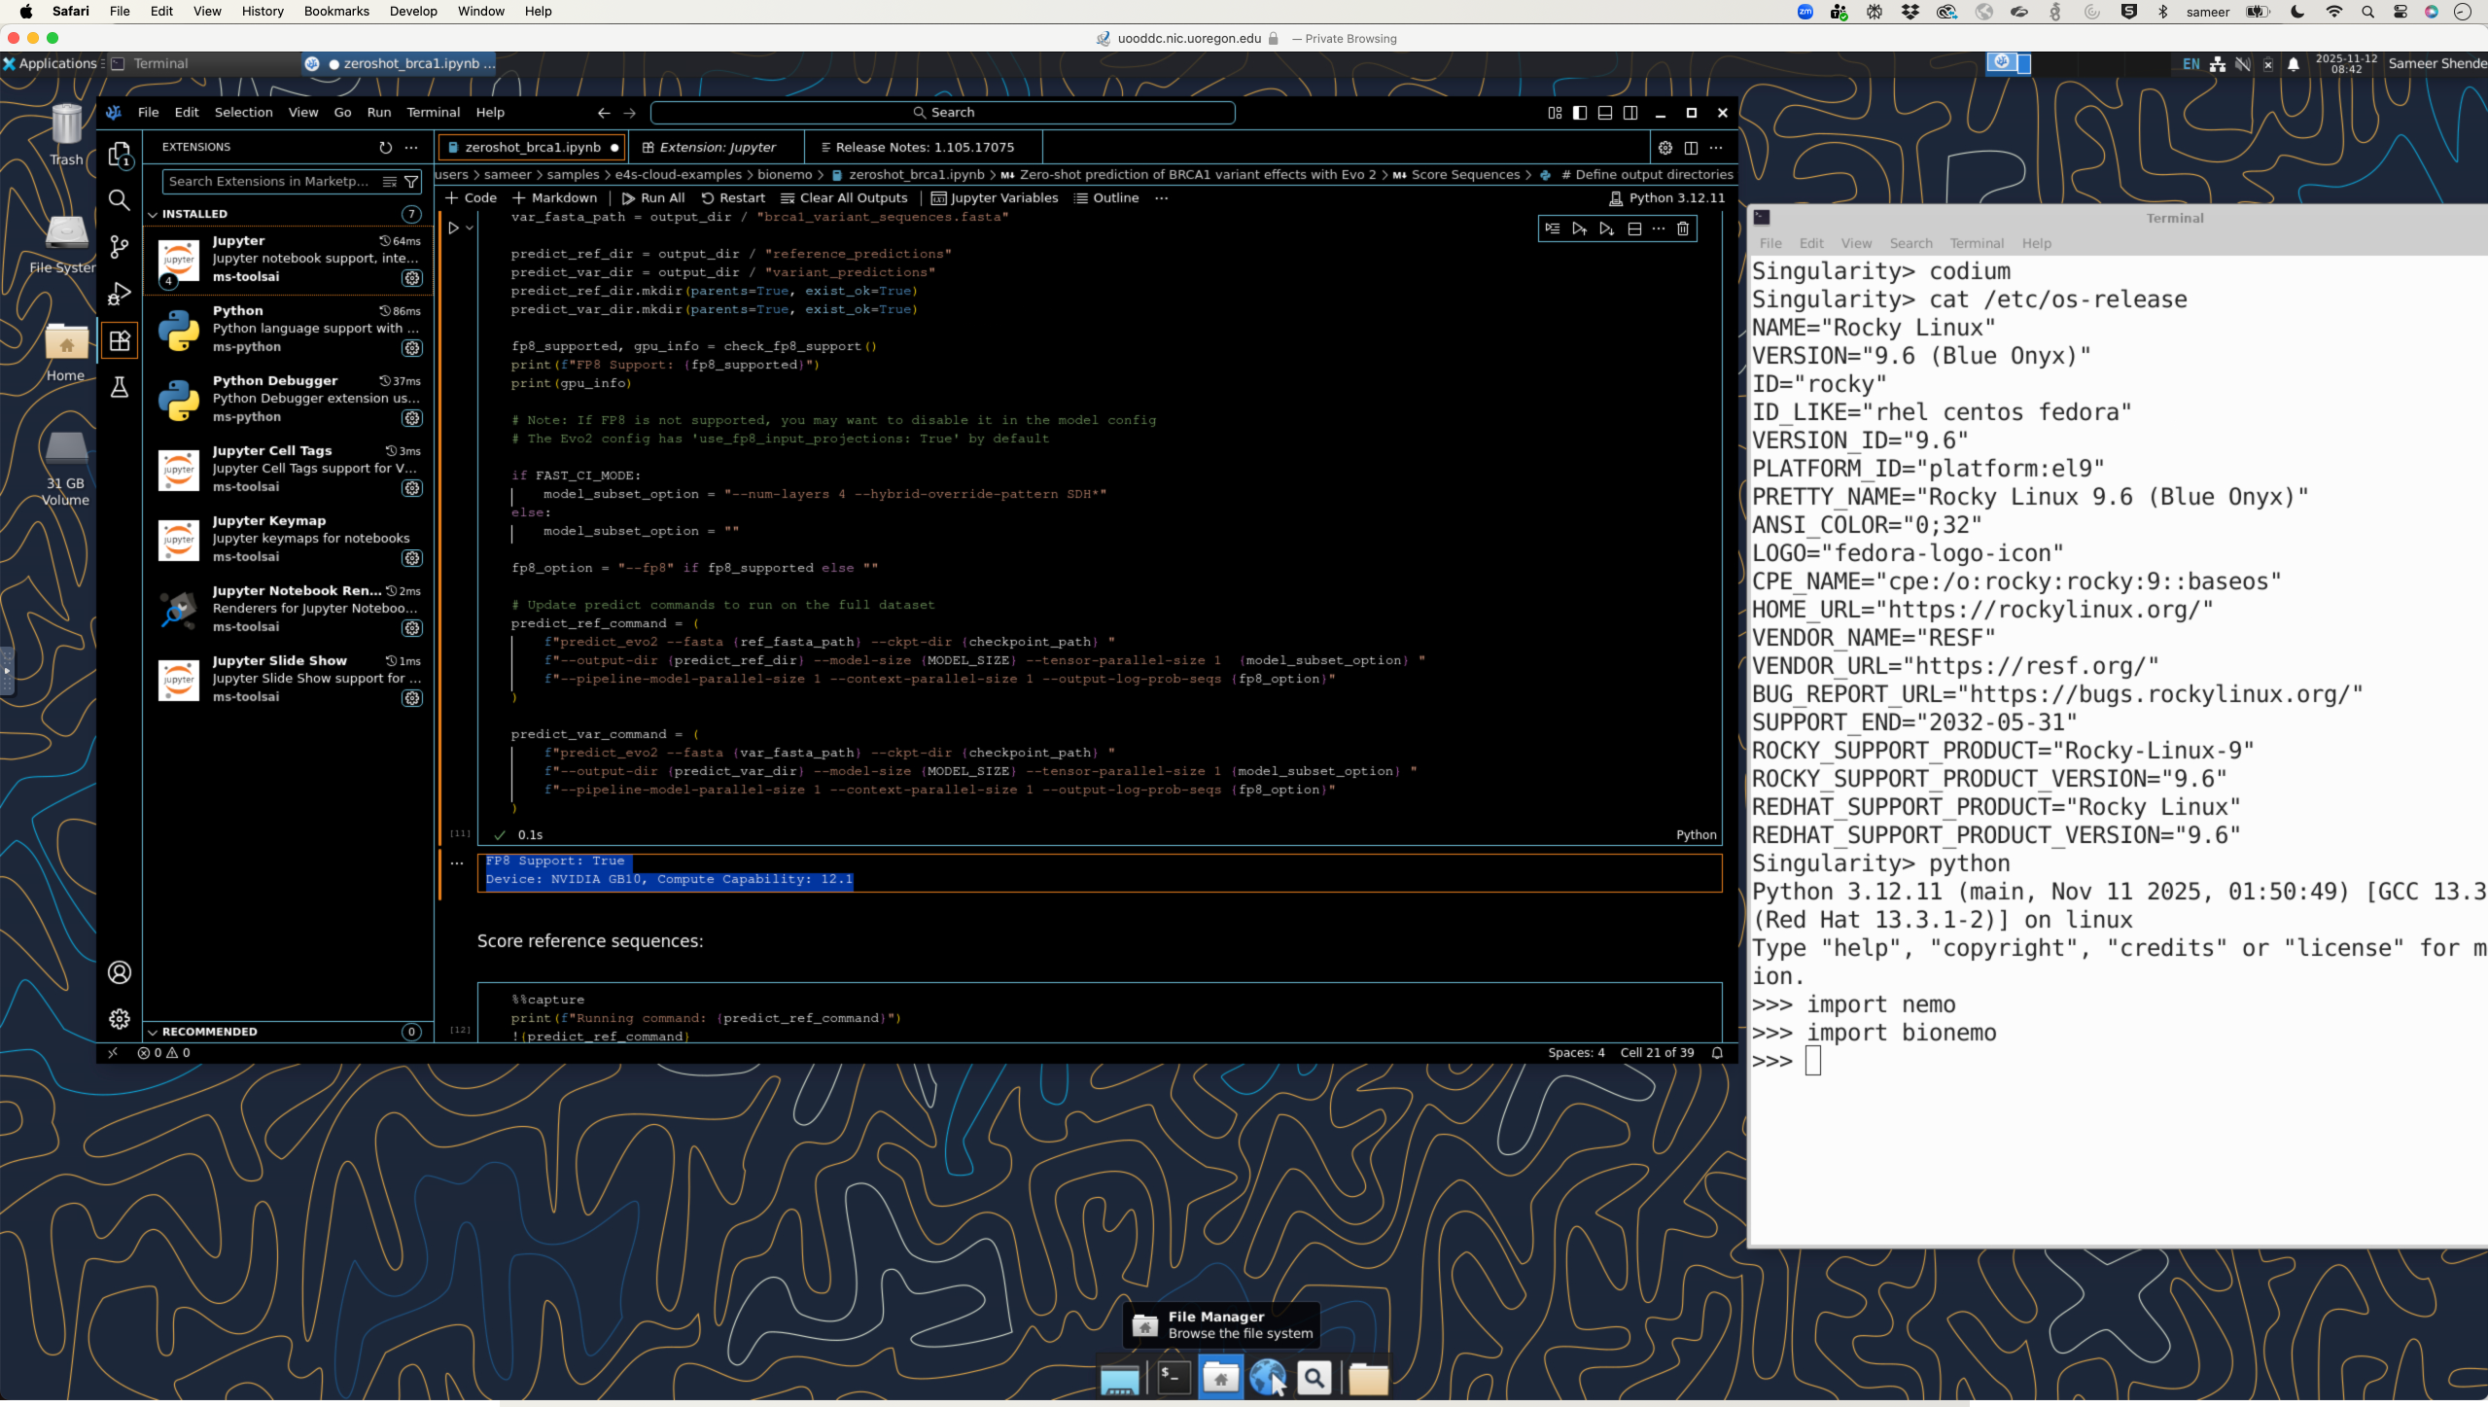
E4S: NVIDIA BioNeMoTM on NVIDIA Grace-Blackwell architecture

Slide 28
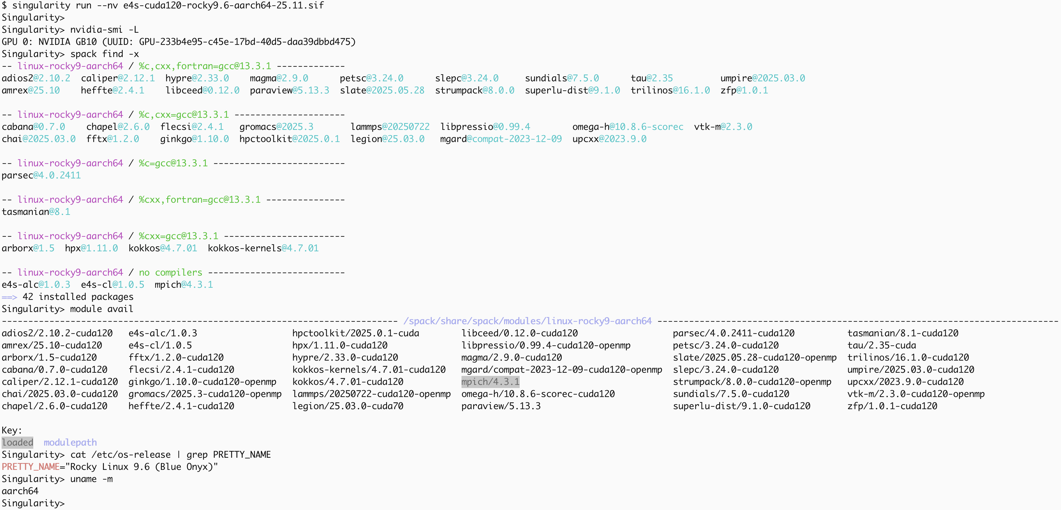
E4S: NVIDIA Grace-Blackwell CUDA 120 Rocky Linux 9.6 image

Slide 29
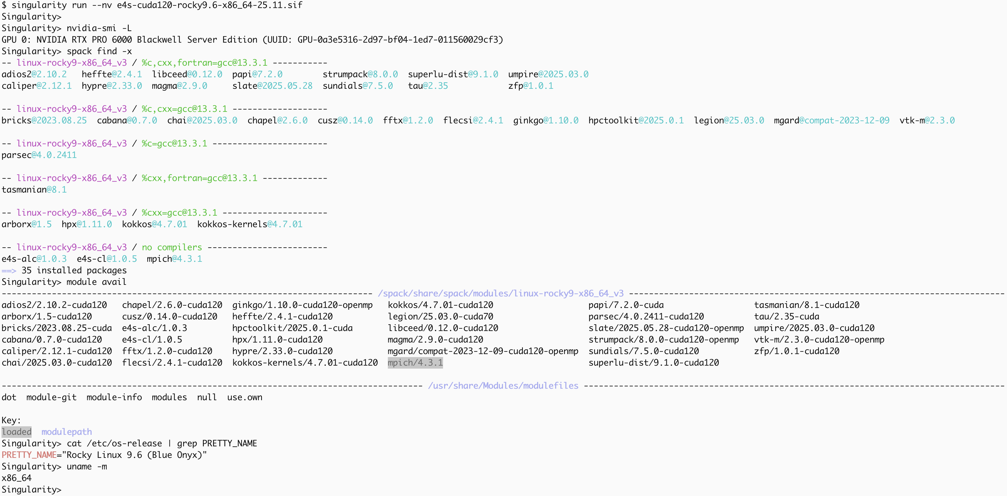
E4S: NVIDIA x86_64-Blackwell (CUDA 120) Rocky Linux 9.6 image

Slide 30
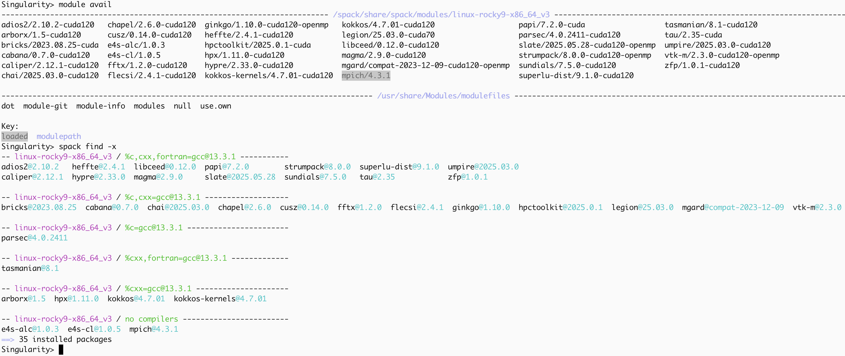
E4S: NVIDIA x86_64-Blackwell (CUDA 120) Rocky Linux 9.6 image

Slide 31
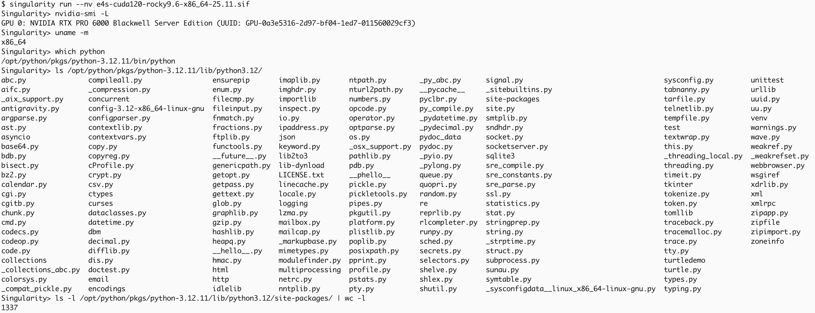
E4S NVIDIA Blackwell x86_64 Rocky Linux 9.6 Python Packages

Slide 32
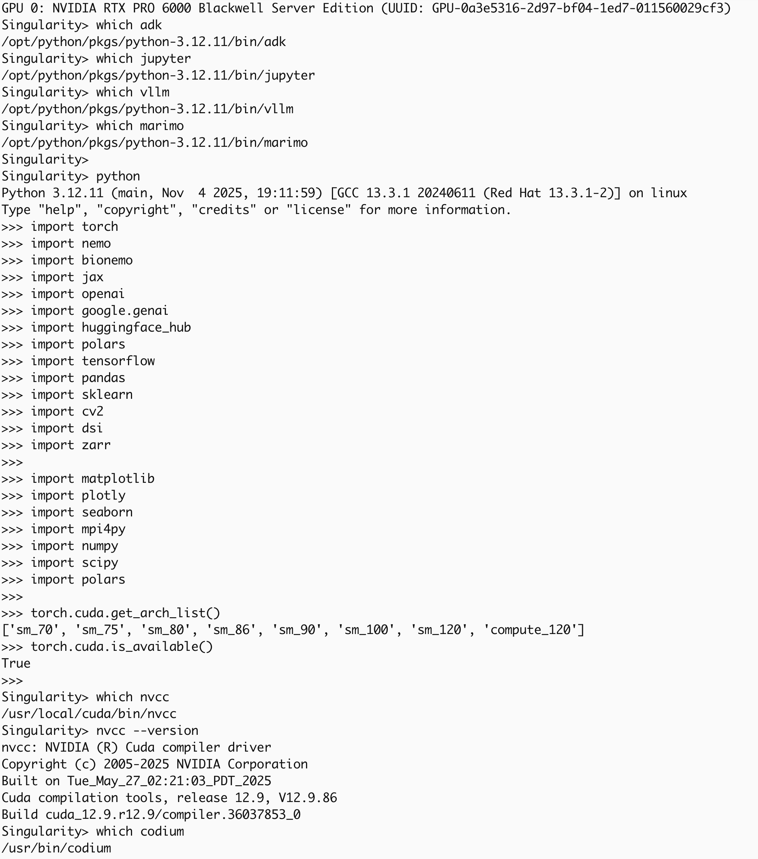
E4S NVIDIA Blackwell x86_64 Rocky Linux 9.6 Python Packages

Slide 33
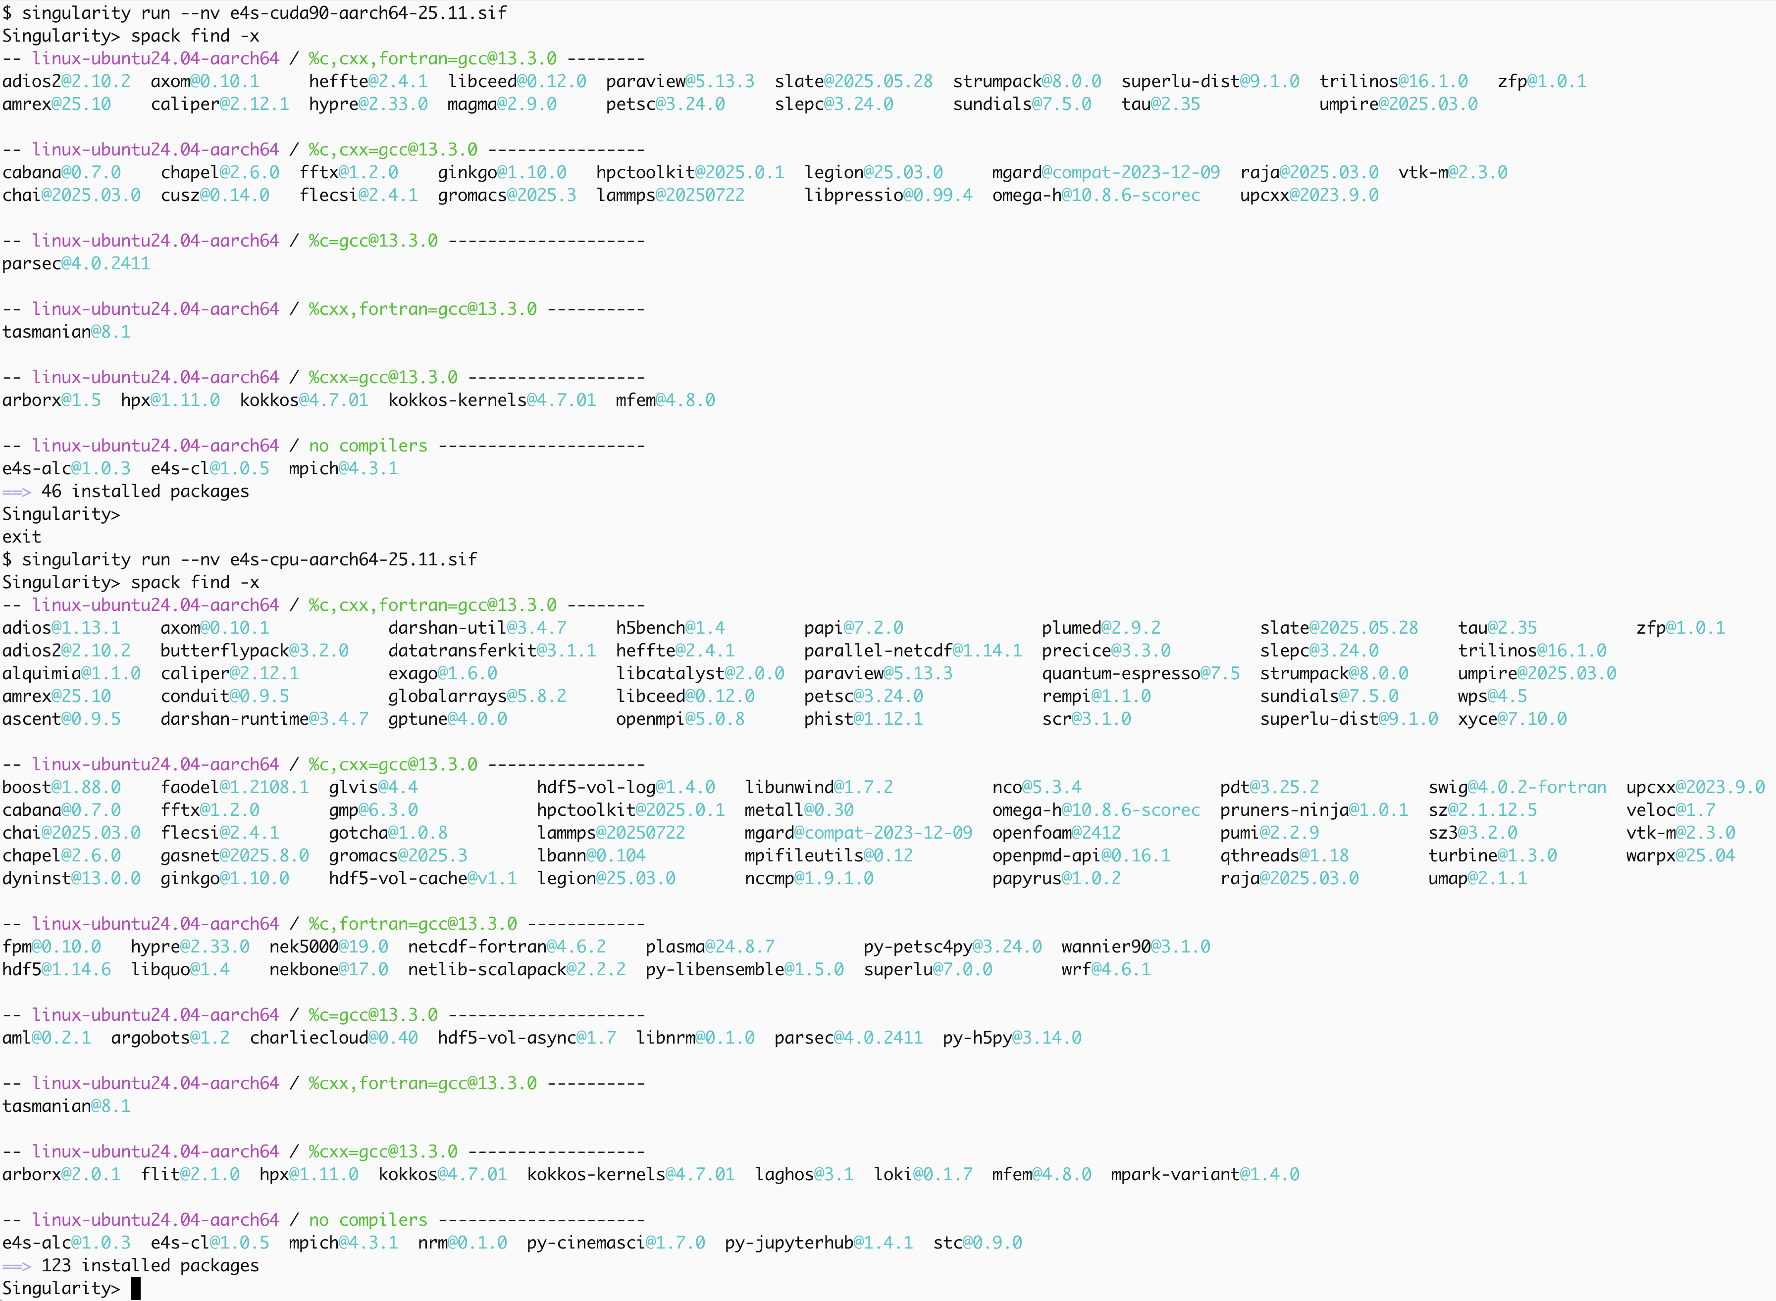
E4S: NVIDIA Grace-Hopper (CUDA 90) Ubuntu 24.04 LTS image

Slide 34
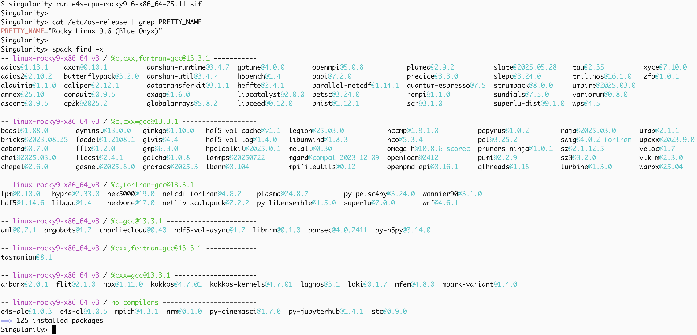
E4S: Rocky Linux 9.6 x86_64 CPU image

Slide 35
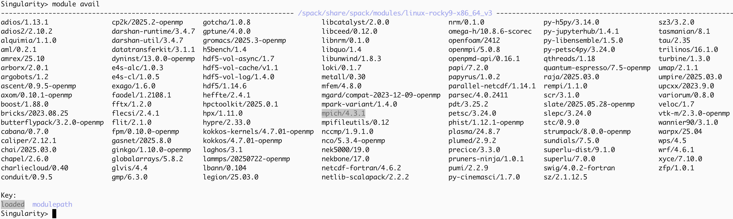
E4S: Rocky Linux 9.6 x86_64 CPU image

Slide 36
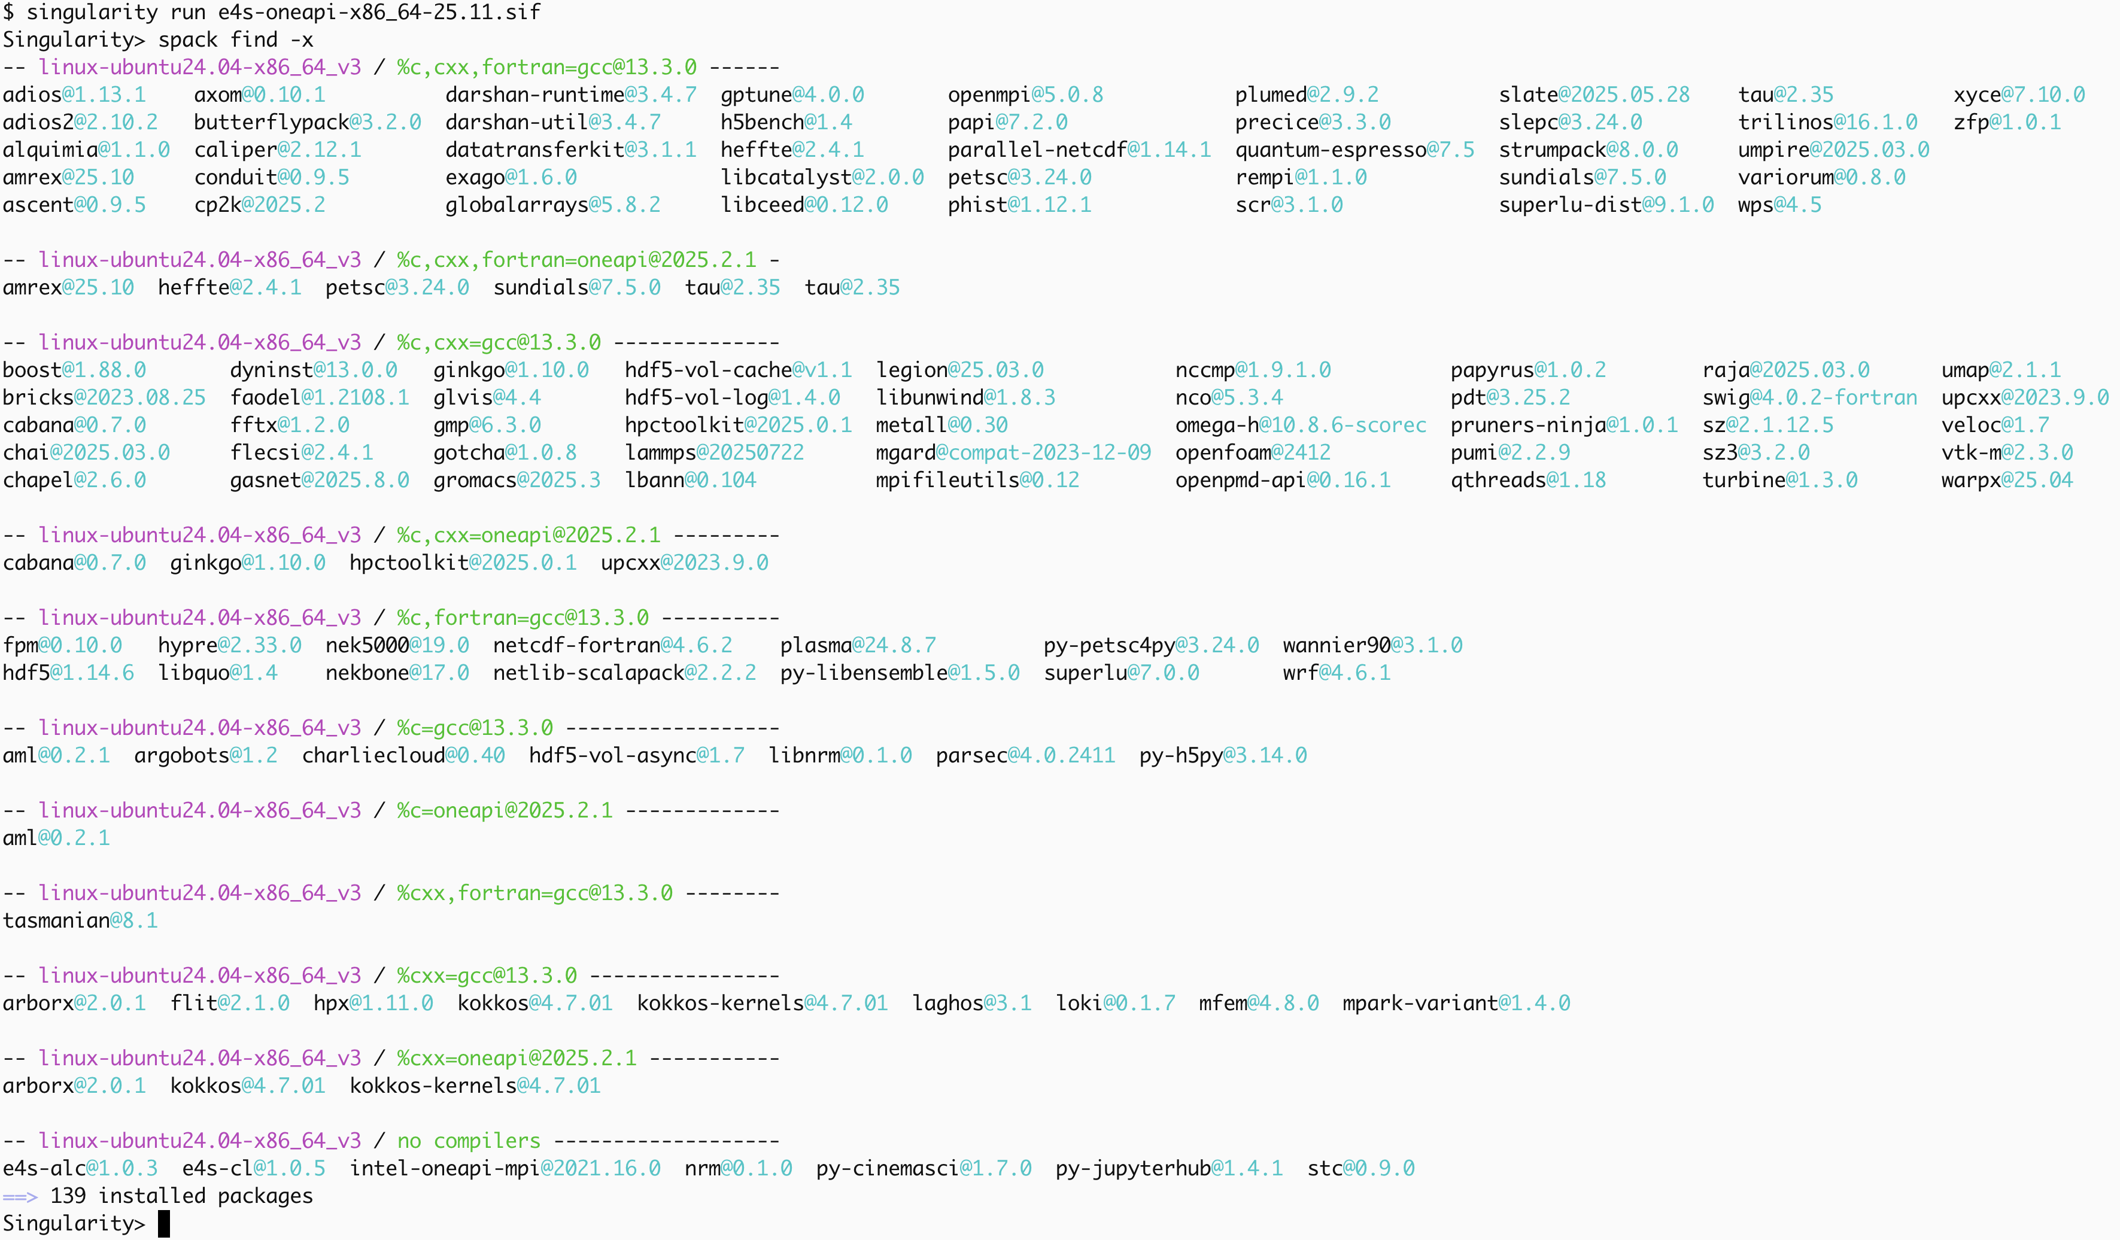
E4S Intel oneAPI Ubuntu 24.04 LTS CPU/GPU image

Slide 37
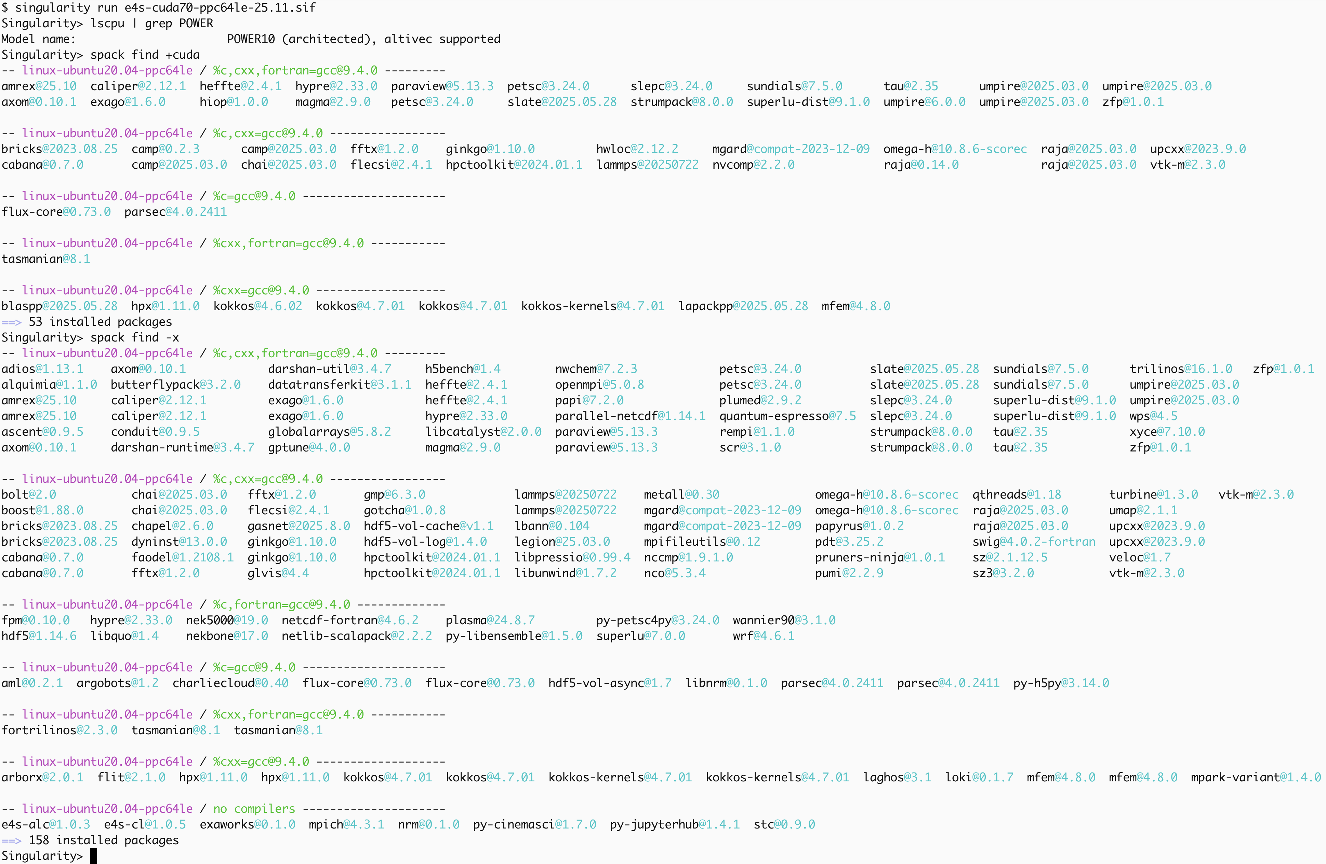
E4S IBM ppc64le Power image with GPU

Slide 38
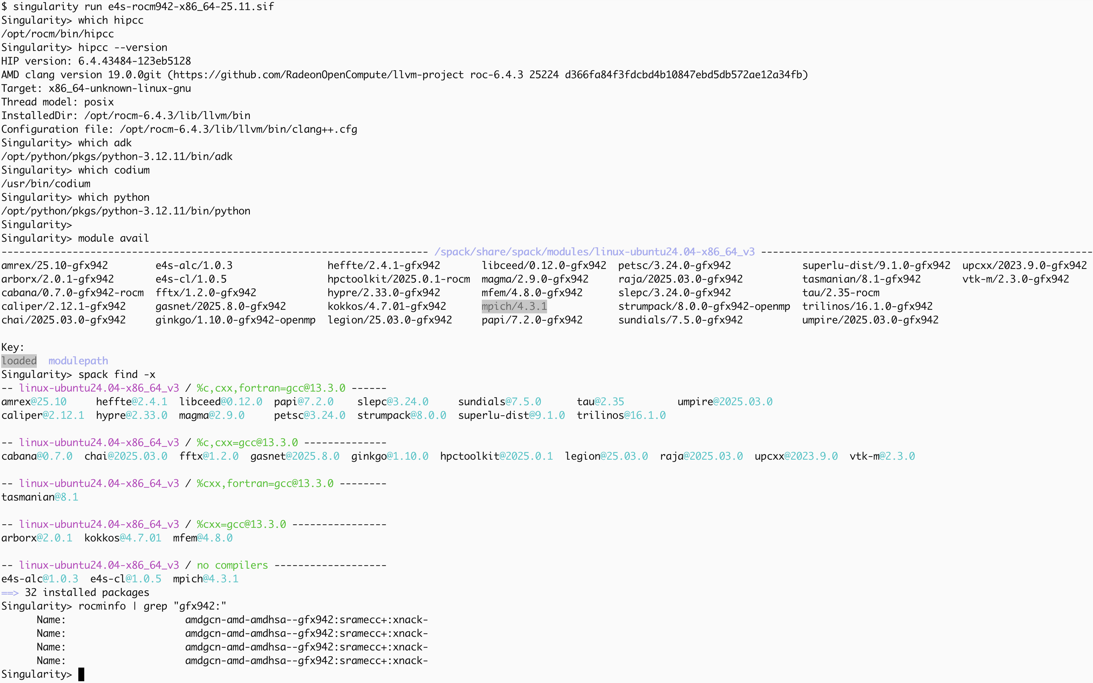
E4S: AMD MI300A GPU support with ROCm 6.4.3

Slide 39
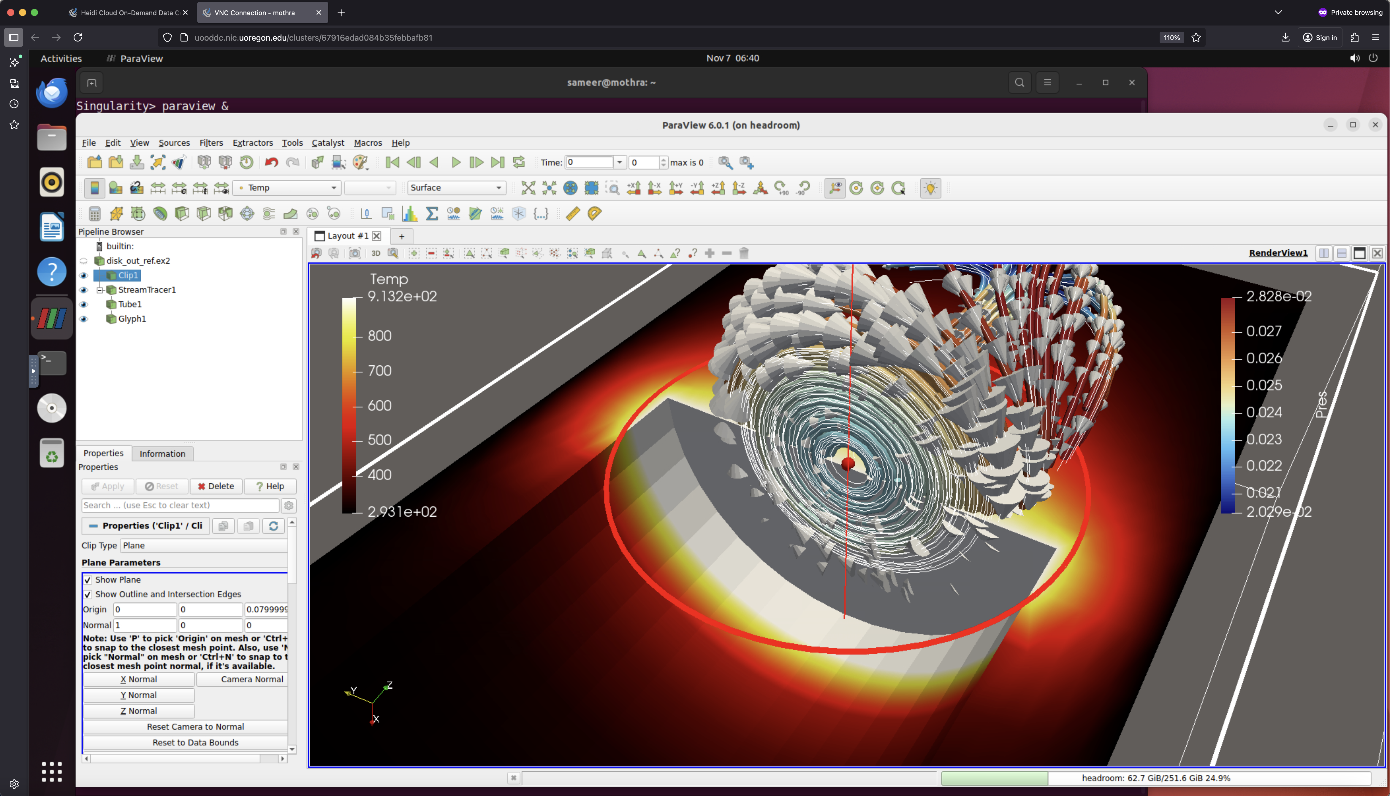
E4S: Visualization Tools: ParaView

Slide 40
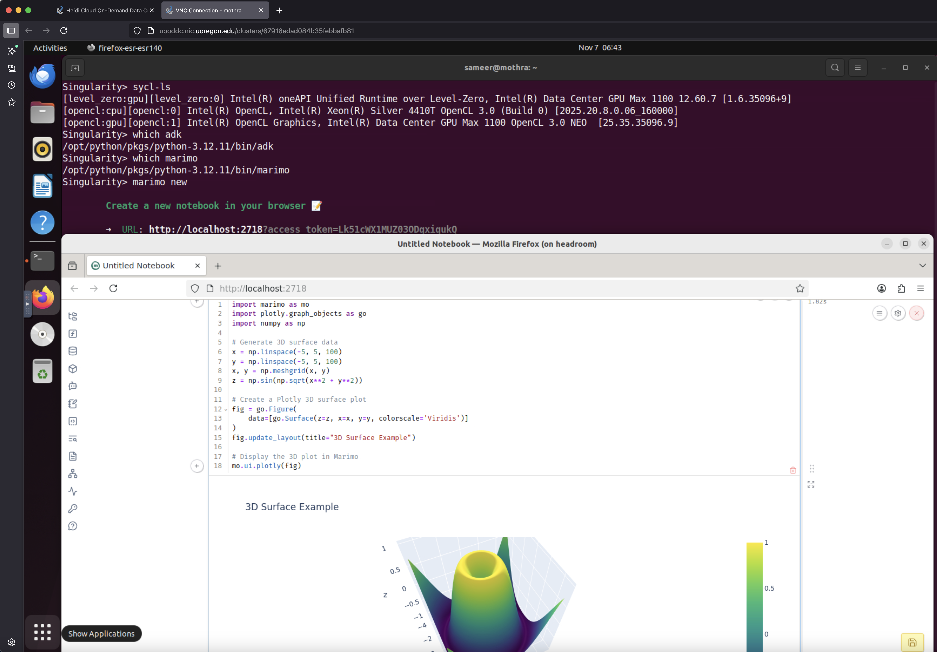
E4S: Marimo Reactive Notebooks

Slide 41
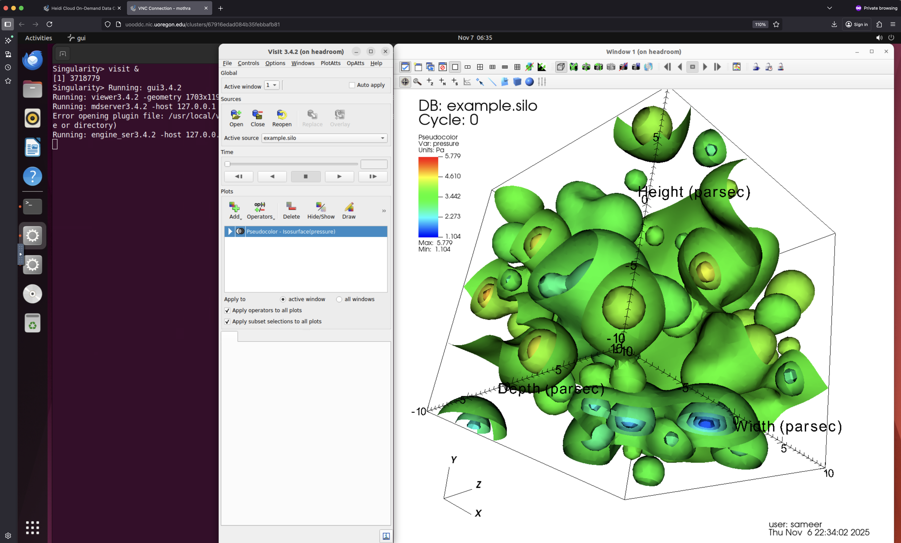
E4S: VisIt

Slide 42
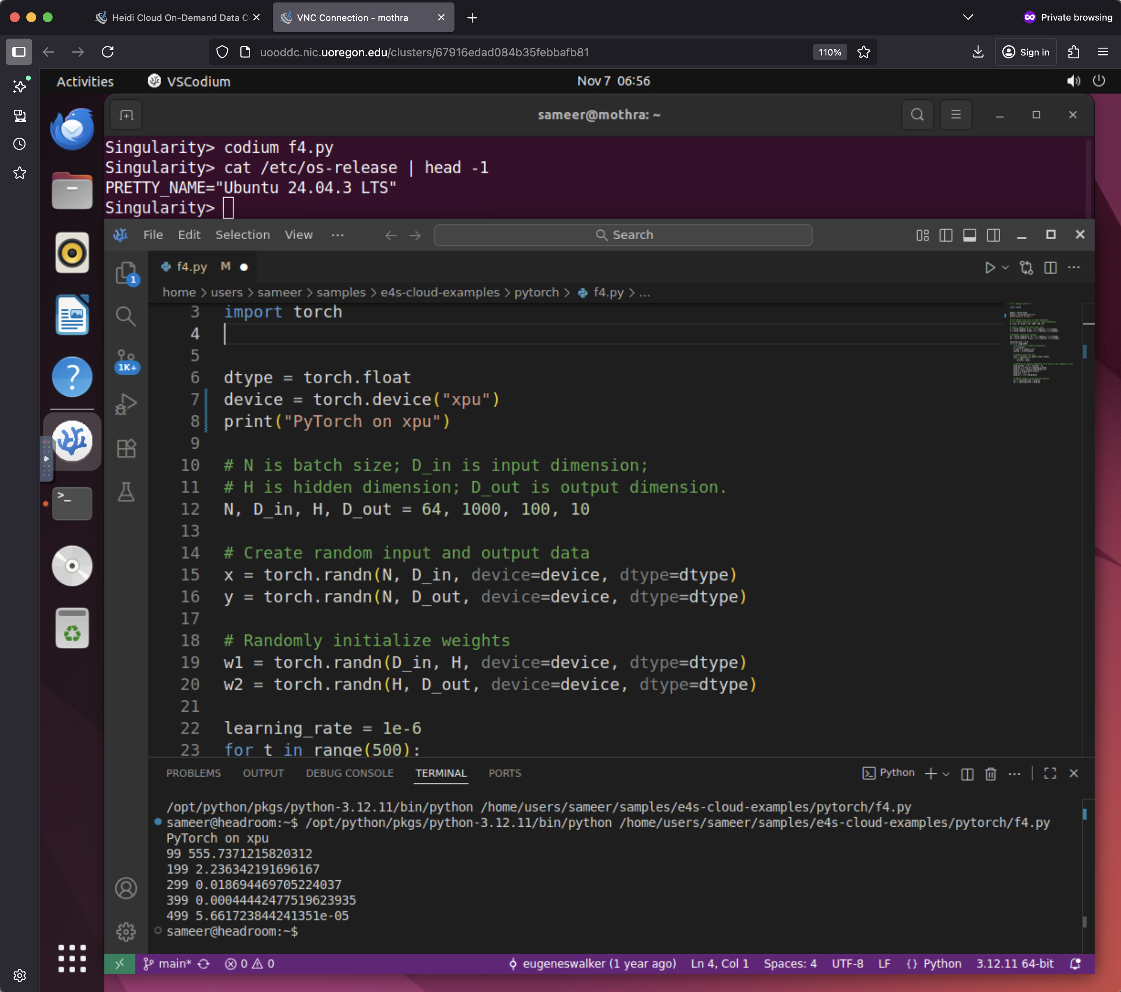
E4S: VS Codium Integrated Development Environment

Slide 43
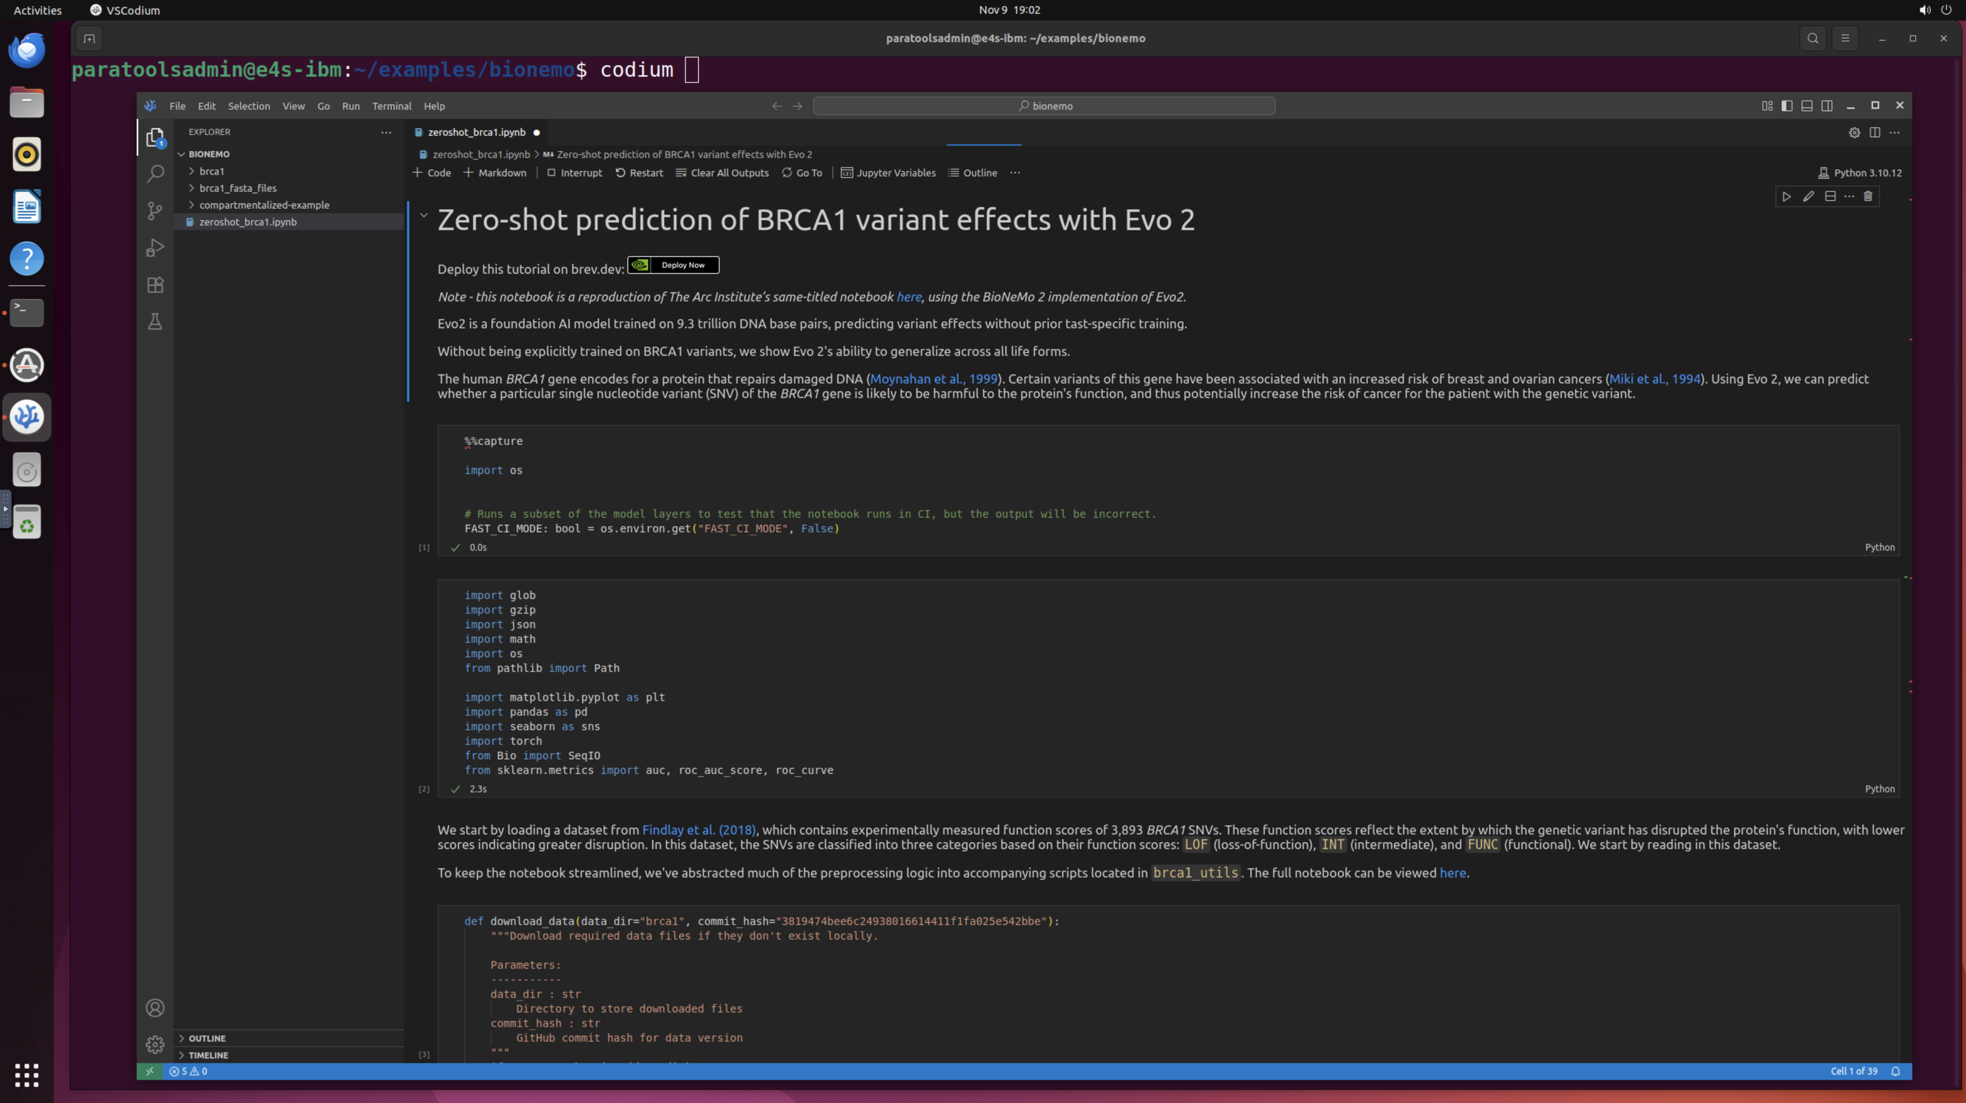
ParaTools Pro for E4STM: NVIDIA BioNeMoTM on IBM Cloud

Slide 44
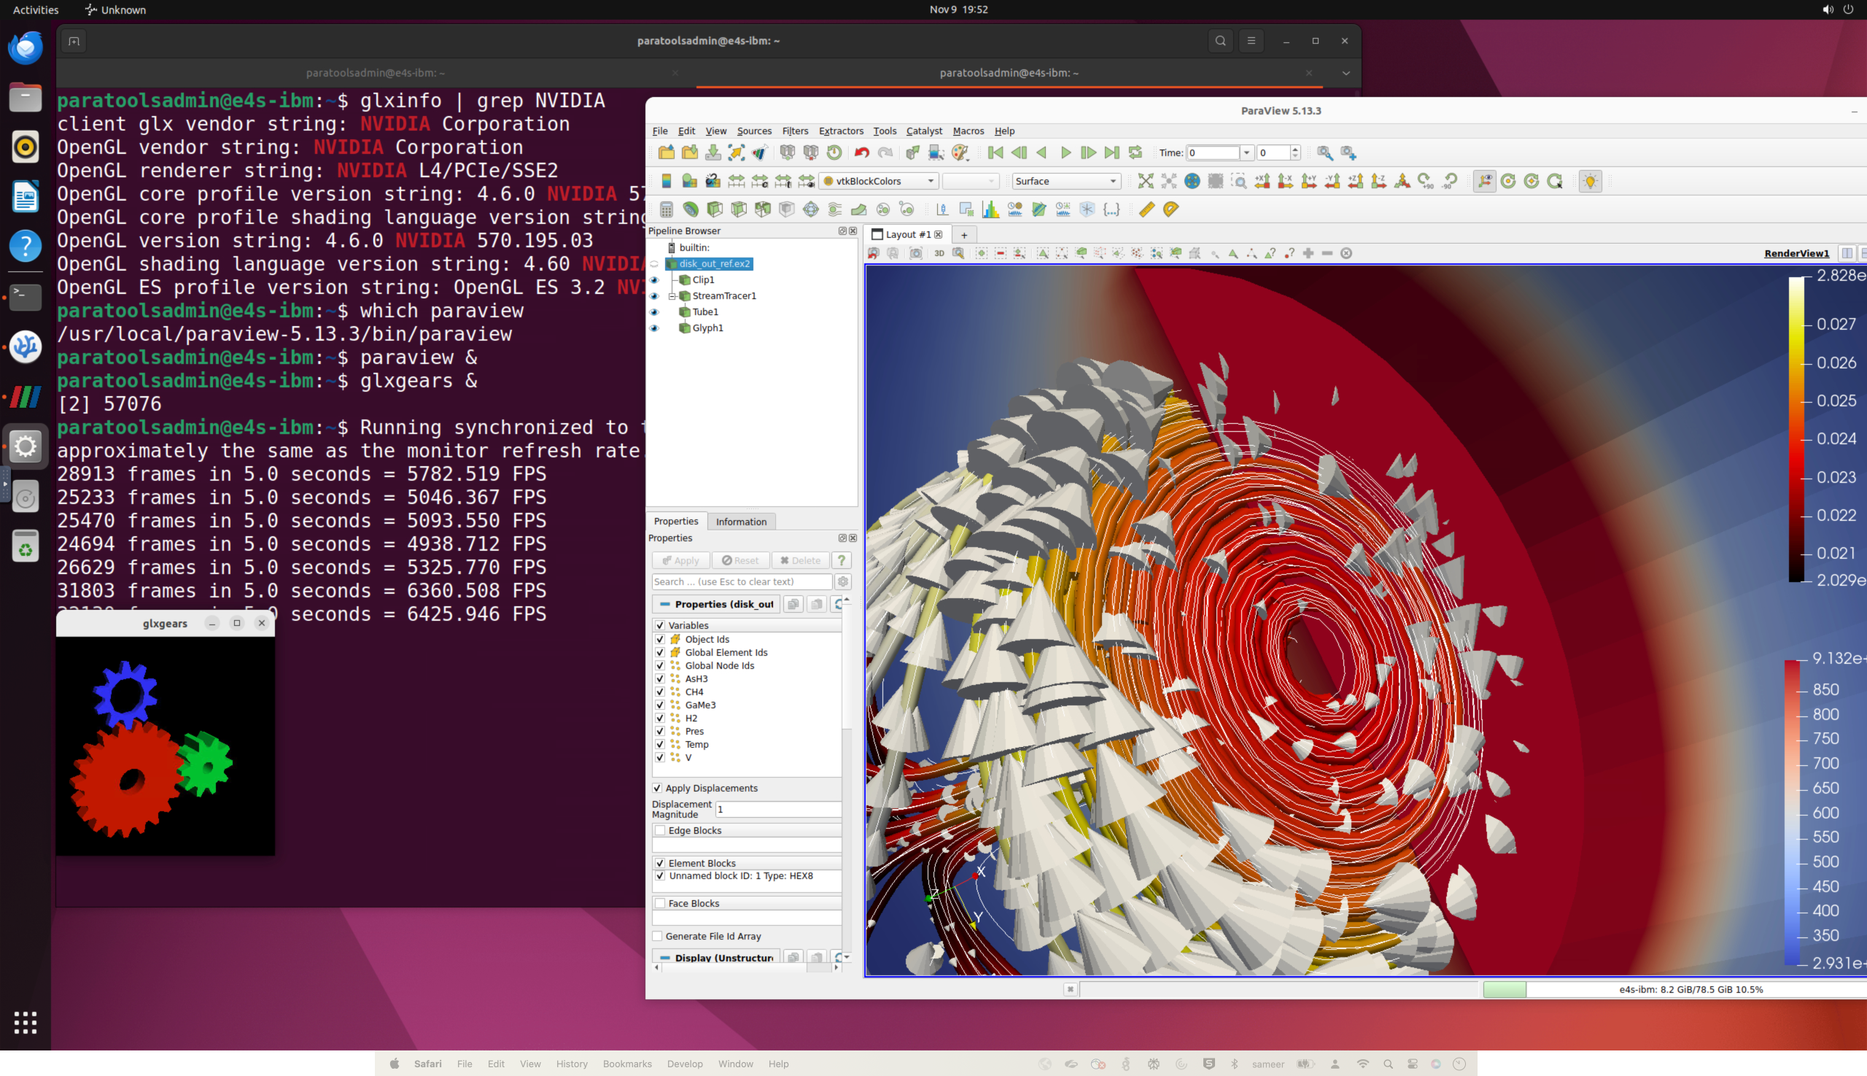
ParaTools Pro for E4STM: HPC-AI Software Ecosystem on Clouds

Slide 45

Acknowledgment
This material is based upon work supported by the U.S. Department of Energy, Office of Science, Office of Advanced Scientific Computing Research, Next-Generation Scientific Software Technologies program, under contract numbers DE-AC02-AC05-00OR22725 and DOE SBIR DE-SC0022502.
https://science.osti.gov/ascr
https://pesoproject.org
https://ascr-step.org
https://hpsf.io
https://www.energy.gov/technologytransitions/sbirsttr

Slide 46
Thank you
https://www.exascaleproject.org
This research was supported by the Exascale Computing Project (17-SC-20-SC), a joint project of the U.S. Department of Energy’s Office of Science and National Nuclear Security Administration, responsible for delivering a capable exascale ecosystem, including software, applications, and hardware technology, to support the nation’s exascale computing imperative.
Thank you to all collaborators in the ECP and broader computational science communities. The work discussed in this presentation represents creative contributions of many people who are passionately working toward next-generation computational science.

Slide 47


